Slide 1
センター2016本試 リスニング

Slide 2
第1問は問1から問6までの6問です。それぞれの問いについて対話を聞き、答えとして最も適切なものを、四つの選択肢(①~④)のうちから一つずつ選びなさい。

Slide 3
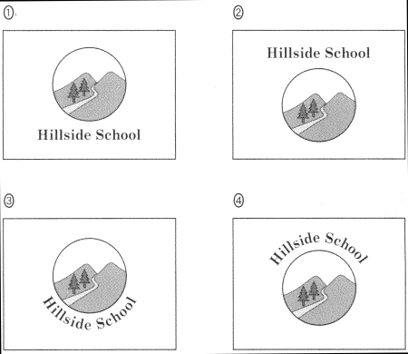
問1 Which is the new school flag?

Slide 4
問1 正解 ③
W： Have you seen the new school flag?
M： The one with the name around the logo?
W： Yes, but the name is under it instead of above it.
M： Yeah, it’s great!

Slide 5
問2 How many new students does the woman expect in total?
① 3
② 7
③ 10
④ 13

Slide 6
問2 正解 ④
M： How many new students have joined the club?
W： Seven the first day, and three since then.
M： How many more do you think will join?
W： I expect three more.

Slide 7
問3 Which class does NOT interest the woman?
① Biology.
② Math.
③ Music.
④ Physics.

Slide 8
問3 正解 ①
M： How are your classes going?
W： Well, I love math, and music is also fun.
M： What about science?
W： I don’t really care for biology, but physics is great.

Slide 9
問4 How much time do they have left to finish the report?
① 10 minutes.
② 20 minutes.
③ 30 minutes.
④ 50 minutes.

Slide 10
問4 正解 ②
W： Hurry up! The report is due soon.
M： I thought you said we still had 50 minutes left.
W： That was half an hour ago!
M： I didn’t realize it’d been that long.

Slide 11
問5 What does the student want to know?
① Where he can go to send an email.
② Where he can talk on his phone.
③ Where the lockers are located.
④ Where the pay phones are located.

Slide 12
問5 正解 ③
W: The meeting has been postponed until Wednesday.
M: Oh, no. I have a piano lesson on Wednesday.
W: Don’t worry. I’ll pass on the information to you.
M: That would be great. Thanks.

Slide 13
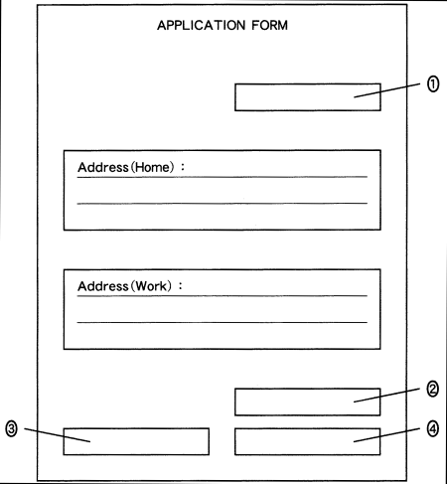
問6 Where should the woman write her telephone number?

Slide 14
問6 正解 ②
M： Please fill out this form and sign at the bottom right.
W： OK.
M： And the date at the top. Oh, also put your telephone number above your signature.
W： All right.

Slide 15
問７～１３は、それぞれの問いについて対話を聞き、最後の発言に対する相手の応答として最も適切なものを、四つの選択肢（①～④）のうちから一つずつ選びなさい。

Slide 16
問7
① I prefer to look it up in the dictionary.
② Sure, but can you wait a minute?
③ Why don’t you use yours?
④ Yes, I forgot to bring mine today, too.

Slide 17
問7 正解 ②
W： What does the word “xenophobia” mean?
M： Hmm, why don’t you look it up in the dictionary?
W： Can I borrow yours? I forgot mine today.

Slide 18
問8
① I don’t know in centimeters.
② I think I’m taller than that.
③ One foot is 12 inches.
④ One meter is 100 centimeters.

Slide 19
問8 正解 ①
M： Hello, I’d like to make a dinner reservation for 7 o’clock tonight.
W： OK, for how many people?
M： Let’s see, there will be eight of us.

Slide 20
問9
① All right. Why were you running?
② Didn’t you recognize her?
③ Oh, right. So what did she say?
④ Why didn’t you meet her yesterday?

Slide 21
問9 正解 ③
M： Guess what? I ran into Emily yesterday and she told me that you…
W： Uh… excuse me, but which Emily was it?
M： The one from Toronto.

Slide 22
問10
① Actually, I prefer jazz.
② In fact, I’m not always right.
③ It makes me feel like dancing.
④ Well, it’s my favorite kind.

Slide 23
問10 正解 ①
W： You don’t like this kind of music, do you?
M： Not really. How did you know?
W： It was just a guess from your facial expression.

Slide 24
問11
① I’m not 20 years old yet.
② I’m not 21 years old yet.
③ I thought it was 18, like my country.
④ I thought it was 21, like my country.

Slide 25
問11 正解 ④
W： Would you like some beer?
M： But, I’m only 20 years old.
W： If you’re 20, you can drink alcohol in Japan.

Slide 26
問12
① As long as you’re ready.
② Five minutes or so.
③ It’s 20 minutes long.
④ We need 30 slides.

Slide 27
問12 正解 ①
W： What else should we get for the party?
M： This fried chicken looks delicious, and it’s 30% off.
W： But if we wait till 7:00, they’ll discount it to half price.

Slide 28
問13
① So will I.
② So will you.
③ Why won’t I?
④ Why won’t you?

Slide 29
問13 正解 ④
M： Summer vacation will be over soon.
W： Have you been enjoying yourself?
M： Yeah, Grandma, but I won’t be able to sleep much this week.

Slide 30
問14 What is the man going to do for his mother’s birthday?
① Cook her French dishes.
② Give her a bottle of wine.
③ Give her some nice flowers.
④ Take her out to a restaurant.

Slide 31
問14 正解 ④
M： I don’t know what to get for my mother’s birthday.
W： Flowers are always nice.
M： Well, I don’t want to give them again this year.
W： I surprised my mother with lunch at a nice French restaurant, and she loved it.
M： That’s what I’ll do! She enjoys good food and wine.

Slide 32
問15 Why is the woman unhappy with the man’s new shirt?
① It’s too expensive for him.
② It’s too large for him.
③ It’s too much like one he already has.
④ It’s too similar to one of her shirts.

Slide 33
問15 正解 ③
M： Guess what I bought myself today.
W： Another shirt?
M： Yes, they had a big sale!
W： Let me see. Are you kidding me?!
M： What’s wrong with it?
W： You bought one with the same pattern last month.
M： But this one has long sleeves.
W： Anyway, I think you should take it back.

Slide 34
問16 What is the man most likely to do?
① Buy the CD at a shop immediately.
② Buy the CD at a shop next week.
③ Download the song immediately.
④ Download the song next week.

Slide 35
問16 正解 ②
W： Angel’s new song’s great!
M： Is the CD already out? I thought it was coming out next week.
W： Yeah, but the song’s available online.
M： Really? Maybe I should download it now.
W： But if you do that, you won’t get the booklet.
M： Oh, I definitely want that! I’d better wait.

Slide 36
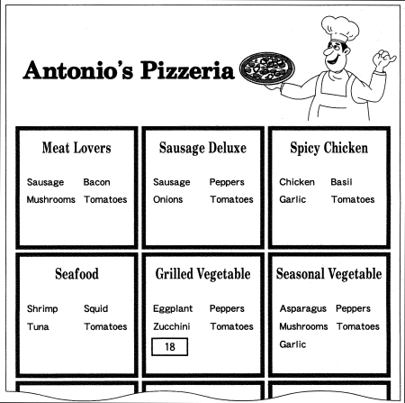
対話の場面 夫婦が宅配ピザのちらし(flyer)を見ながら注文の相談をしています。
問17 Which pizzas are available at a discount?
① Sausage Deluxe and Meat Lovers
② Sausage Deluxe and Spicy Chicken
③ Seafood and Meat Lovers
④ Seafood and Spicy Chicken
問18 What should be in [ 18 ] in the flyer?
① Asparagus
② Garlic
③ Mushrooms
④ Onions
問19 Which pizzas are they going to order?
① Meat Lovers and Grilled Vegetable
② Meat Lovers and Seasonal Vegetable
③ Spicy Chicken and Grilled Vegetable
④ Spicy Chicken and Seasonal Vegetable

Slide 37
問17 正解 ④ 問18 正解 ④ 問19 正解 ②
M： I feel like having pizza tonight.
W： Here’s a flyer from the new shop.
M： I’d like one with sausage.
W： How about the Sausage Deluxe?
M： Let me see. But it has onions.
W： Oh, you know I can’t stand them.
M： It says on the other side that these two are on sale. The Seafood looks delicious.
W： I’m not in the mood for seafood. I’d prefer the other one, Spicy Chicken.
M： Hmm… but this one looks even better. Oh, it’s regular price.
W： Meat Lovers? OK. The kids will be happy with that. But for the second pizza, I’d like one with lots of vegetables like asparagus or eggplant.
M： They have Grilled Vegetable and Seasonal Vegetable. They’re kind of similar, but the Seasonal has asparagus, mushrooms and garlic. The Grilled has eggplant, zucchini and… onions.
W： Oh no.
M： So, if you don’t mind garlic, shall we go with Seasonal Vegetable?
W： Sure. Should I call?

Slide 38
問20 When Jane was out of the room, what did she think the speaker and her husband were doing?
① Cheering. ② Cooking.
③ Fighting. ④ Laughing.
問21 How did the speaker find out how to cook a lobster?
① By asking her husband.
② By checking the Internet.
③ By looking at a cookbook.
④ By talking to a neighbor.
問22 What happened to the lobster at the end of the story?
① It was cooked.
② It was given away.
③ It was set free by the husband.
④ It was taken home by the boss.

Slide 39
問20 正解 ③ 問21 正解 ④ 問22 正解 ②
Now let me tell you a story. When we lived in Japan many years ago, my American friend Jane came to visit us with her Japanese boss, who wanted to meet my husband. After he left, we decided to open the gift that he had brought. Surprisingly, it was a neatly packed live lobster. I started laughing and shouting, “It’s alive! It’s alive!” But Jane, who’d just gone to the bathroom, thought I was yelling, “It’s a lie! It’s a lie!” She thought we were having an argument, so she was afraid to come back into the living room. When she finally returned, she realized that we were not fighting, but laughing at such an unexpected gift.
We had never cooked a lobster before, so we didn’t know what to do. In those days there was no Internet to get information, so we went and asked a neighbor. Meanwhile, we had put the lobster in a sink full of water.
When we came home the lobster had become so lively that we no longer had the heart to cook it. We managed to get it back into the box, and we gave it to the neighbor instead.

Slide 40
会話の場面 英語の授業で, 500万円の予算があればどのように学校を改善できるのかIchiro, Reina, Mayukoが討論しています。
問24 Which of the following was proposed in the discussion?
① Buying tablet PCs.
② Installing solar panels.
③ Painting the picnic tables.
④ Sending students abroad.
問24 What improvement do all the speakers like?
① A bicycle parking roof.
② Flowers near the entrance.
③ Grass in the school yard.
④ New picnic tables.
問25 Which of the following do Ichiro and Mayuko have different opinions about?
① Buying more library books.
② Installing air conditioning.
③ The need for school-wide Wi-Fi.
④ The value of educational websites.

Slide 41
問23 正解 ② 問24 正解 ① 問25 正解 ③
Ichiro: So, Reina, what would you do if we had five million yen to improve our school?
Reina: Hmm. I can think of so many things, Ichiro. One idea would be to put a roof over the bicycle parking area. Don’t you hate it when it rains and your bike gets wet? We could also put some picnic tables on the grassy area over by the bike stands. That would give students a place to have lunch or hang out after school. And we could make the entrance look a lot nicer. What about painting it a bright color and buying some plants and flowers?
Ichiro: Well, those are all great ideas, Reina. I especially like putting a roof over the bicycles. But to tell the truth, if we had that much money to spend, I think it’d be better to spend it on one big thing rather than a lot of little things.
Reina: Oh, yeah. Good point, Ichiro.
Ichiro: I think it’d be better if we had free Wi-Fi everywhere in the school. Internet access would help us study more. We could get a lot of information that would help us with our homework, and there are so many educational websites that are usually free. Best of all, we could chat with the students at our sister school in Australia. Don’t you agree, Mayuko?
Mayuko: Well, that’s a pretty good idea, Ichiro, but the library has Internet access, and most students already have smartphones or tablet PCs. I think it’d be better to buy solar panels instead. That electricity could be used all over the school―we could have hot water in the winter and air conditioning in the summer. Oh, I know! We could make a roof for the bicycles out of the solar panels. That would kill two birds with one stone!

