Slide 1
センター2016追試 リスニング

Slide 2
第1問は問1から問6までの6問です。それぞれの問いについて対話を聞き、答えとして最も適切なものを、四つの選択肢(①~④)のうちから一つずつ選びなさい。

Slide 3
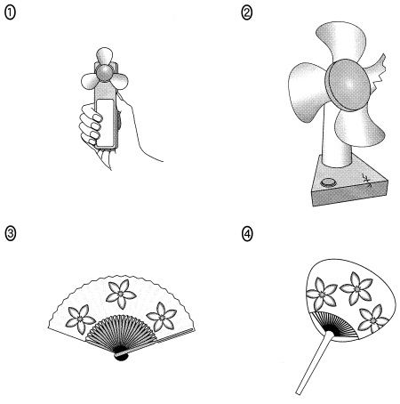
問1 Which fan is the woman looking for?

Slide 4
問1 正解 ③
W: I’m looking for my fan.
M: It’s in the closet, but I think it’s broken.
W: No, the folding fan with the flower pattern.
M: Oh, that’s in the drawer.

Slide 5
問2 How many students will not be able to attend the workshop?
① 3
② 5
③ 8
④ 15

Slide 6
問2 正解 ②
M: How many students registered for the workshop?
W: Forty-two, and eight more want to join.
M: But we only have room for 45.
W: Then, some of them won’t be able to attend.

Slide 7
問3 How are they going to get the cake?
① Ask Peter to order it.
② Buy it at a bakery.
③ Have one delivered.
④ Make it themselves.

Slide 8
問3 正解 ④
W: Peter ordered the food to be delivered for the party.
M: We still need a cake though.
W: How about baking one?
M: Yes, that’ll be better than buying one from a bakery.

Slide 9
問4 How many tickets did the woman probably use?
① 4
② 7
③ 10
④ 11

Slide 10
問4 正解 ②
M: It’s cheaper to buy train tickets in sets.
W: Not always.
M: But you get eleven for the price of ten!
W: True, but I lost my wallet with the last four in it!

Slide 11
問5 What will the man probably do on Wednesday?
① Attend the meeting.
② Postpone the piano lesson.
③ Reschedule the meeting.
④ Take the piano lesson.

Slide 12
問5 正解 ④
W: The meeting has been postponed until Wednesday.
M: Oh, no. I have a piano lesson on Wednesday.
W: Don’t worry. I’ll pass on the information to you.
M: That would be great. Thanks.

Slide 13
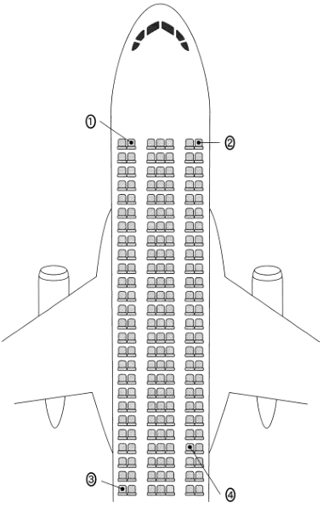
問6 Where will the woman be sitting on the airplane?

Slide 14
問6 正解 ①
M: How about this seat?
W: A window seat in the back? I prefer an aisle seat.
M: There’s one available in the front. It has more space.
W: Great, I’ll take that one.

Slide 15
問７～１３は、それぞれの問いについて対話を聞き、最後の発言に対する相手の応答として最も適切なものを、四つの選択肢（①～④）のうちから一つずつ選びなさい。

Slide 16
問7
① Bus number 27 didn’t go there.
② It takes about 10 minutes by bus.
③ The school bus doesn’t stop here.
④ You could take bus number 35.

Slide 17
問7 正解 ④
M: Excuse me, does the next bus stop at Yamada Elementary School?
W: No, but it stops one block from there.
M: Are there any buses that stop in front of the school?

Slide 18
問8
① I don’t know in centimeters.
② I think I’m taller than that.
③ One foot is 12 inches.
④ One meter is 100 centimeters.

Slide 19
問8 正解 ①
W: How tall are you?
M: 5 feet 9 inches.
W: What’s that in centimeters?

Slide 20
問9
① OK, never mind then.
② OK, we have time.
③ So let’s get out of line.
④ So let’s hurry up.

Slide 21
問9 正解 ①
W: What are all those people lining up for?
M: A new pancake shop is opening today. Let’s get in line!
W: No way. I hate lines.

Slide 22
問10
① He doesn’t need it.
② He’s funny.
③ I agree with you.
④ I doubt it.

Slide 23
問10 正解 ④
M: Kevin is a really funny guy.
W: He sure is!
M: Do you think we could become as funny if we got training or practice?

Slide 24
問11
① Oh, that’s an interesting idea.
② Oh, that’s very nice of you.
③ Thanks, but you have to do it.
④ Thanks, I’ll take a ferry instead.

Slide 25
問11 正解 ②
W: You’re going to Hiroshima next week, right?
M: Yeah. Oh, do you know how much the ferry to Miyajima is?
W: I don’t, but I can check it for you.

Slide 26
問12
① As long as you’re ready.
② Five minutes or so.
③ It’s 20 minutes long.
④ We need 30 slides.

Slide 27
問12 正解 ②
W: Is everyone ready for the presentation?
M: Not quite. We need some time to check if all the slides are OK.
W: Well then, how long do you need?

Slide 28
問13
① No, it’s hard.
② Sort of.
③ Sounds great.
④ Yeah, it’s easy.

Slide 29
問13 正解 ②
M: I heard you joined a new dance class.
W: Yeah, I’m taking hip-hop lessons.
M: Isn’t it hard?

Slide 30
問14 Why are they having a party?
① Nancy is going back to Japan.
② Nancy is leaving for Tokyo.
③ Nancy is moving to Kyoto.
④ Nancy is returning to England.

Slide 31
問14 正解 ③
W: Have you heard about Nancy’s farewell party?
M: Isn’t she here until next year?
W: Actually, her father is being transferred to Kyoto.
M: Oh, I thought they were going back to England.
W: No. She won’t be in Tokyo, but she’ll still be in Japan.
M: Good. We can always go and see her.

Slide 32
問15 Which statement is correct?
① The man already gave her two stickers.
② The man will give her the mug.
③ The woman still needs one more sticker.
④ The woman will buy the mug.

Slide 33
問15 正解 ③
W: Are you collecting those stickers to get the Snoopy mug?
M: No, are you?
W: I really want one, but the campaign ends this Sunday.
M: How many more stickers do you need?
W: Just two.
M: Well, you can have this one.
W: Great! If I have another coffee tomorrow, I can get the mug.

Slide 34
問16 Why is the man unhappy with the woman?
① She kept the sweater he wanted to throw away.
② She planned to throw away a present from him.
③ She threw away his clothes he wanted to keep.
④ She wore out the sweater in just two years.

Slide 35
問16 正解 ②
M: Oh, you’re finally cleaning your closet!
W: Yes. I’m getting rid of clothes I haven’t worn in the last two years.
M: That’s a great idea.
W: Look at all these things I’m going to throw away!
M: Wait a second. That’s the sweater I gave you for your birthday!
W: OK. I’ll keep it.

Slide 36
対話の場面 二人の子ども(MegとPatty)を連れた夫婦が，動物園でイベント表を見ながらその日の午後の予定について話しています。
問17 How long is the guided tour?
① 10 minutes. ② 20 minutes.
③ 30 minutes. ④ 60 minutes.
問18 Which one of these events will the whole family go to?
① Koala feeding. ② Giraffe feeding.
③ Guided tour. ④ Sea lion show.
問19 Which statement is correct?
① One of the children is under 10 years old.
② The family is at the zoo on a weekend.
③ The father has registered for the workshop.
④ The mother will go to two feedings.

Slide 37
問17 正解 ③ 問18 正解 ④ 問19 正解 ①
M: So, what’s our afternoon plan?
W: Meg has been really looking forward to the photography workshop.
M: Patty is not old enough for that, so I’ll take her to one of the feedings.
W: The koala one has just started. The giraffe one is at 2:15.
M: I’ll take Patty to that, and you and Meg go to the workshop.
W: You can join the 2:30 guided tour while we’re at the workshop.
M: The tour and the workshop finish at the same time.
W: Oh, yeah.
M: So we can meet at the souvenir shop.
W: Patty has been talking about watching a sea lion show.
M: We won’t be able to get seats for the three o’clock one.
W: That’s true. We should go to the last one.
M: While we’re waiting, we can watch the chimpanzee feeding.
W: Everything’s settled then.
M: Hang on! It says here that we need a reservation for the workshop.
W: You’d better run!

Slide 38
問20 Why did the speaker feel excited on the train?
① She had decided to become a professional athlete.
② She had planned to meet Ken in Australia.
③ She had received a full scholarship.
④ She had reserved her ticket to the US.
問21 What is true about Ken?
① He could speak English before he went to America.
② He has friends from many different countries.
③ He is the speaker’s college classmate.
④ He was a professional golfer in Japan.
問22 How was the speaker inspired by Ken?
① She became determined to pay for her trip.
② She decided to make friends before going overseas.
③ She felt optimistic about her athletic ability.
④ She gained confidence about going abroad.

Slide 39
問20 正解 ③ 問21 正解 ③ 問22 正解 ④
I was on the train heading home feeling really excited, but at the same time pretty anxious. I had just heard that I had been selected to study sports science at an Australian university. My scholarship included everything―airfare, school fees, rent, and spending money. I was happy because I’d worked so hard to make this happen. But I started to get a little scared. Could I live in another countiy for a whole year? Then by chance, I met my best friend from high school. I hadn’t seen Ken for ages, but I always wondered about him. It turned out that he’d been in the US for the past two years trying to become a professional golfer, and he’d just played in his first pro tournament. He told me that it was pretty tough at first because he couldn’t speak English at all, and he didn’t have any friends there. Now, he’s not only a pro golfer, but also a fluent English speaker with friends from all over the world. Ken’s dream had come true. That really inspired me, and I’m ready for my own adventure now. I’m still kind of nervous, but I know I can do it.

Slide 40
会話の場面 英語の授業で, Shoji, Kyoko, Yukariが３週間の理想の旅行について話し合っています。
問23 What does Kyoko want to do?
① Go to many cities in one European country.
② Go to many European countries.
③ Travel around Europe by boat.
④ Travel around Europe by plane.
問24 What do Shoji and Yukari both want to do?
① Go to beaches.
② See historical sites.
③ Travel by train.
④ Visit several countries.
問25 What do all the speakers say they want to do?
① Enjoy the food.
② Meet the people.
③ View the architecture.
④ Visit the museums.

Slide 41
問23 正解 ② 問24 正解 ① 問25 正解 ①
Shoji: Let’s talk about where we’d go if we could take a 3-week trip anywhere in the world. Any ideas, Kyoko?
Kyoko: Well, it’s hard to decide. Hmm. I know. I can imagine myself visiting Anne Frank’s house in Amsterdam, having dinner in Paris, and riding a gondola in Venice. Yeah, my dream is to travel all across Europe. I know you can buy a train pass that lets you go almost anywhere. You can see all the famous museums and eat a lot of really good food in each country. What do you think, Shoji?
Shoji: Well Kyoko, I agree that it’d be nice to travel everywhere like that, but most of your time would be spent on trains! That’s a waste of time. I wouldn’t want to spend my three weeks doing that. I’d rather stay in just one country, like Italy, instead. I want to be an architect someday, so it’d be great to go sightseeing in cities like Rome, Venice, and Florence. I also want to go to the beach. I’ve heard that Italian beaches are really beautiful. And I’m crazy about Italian food, so I wouldn’t mind eating that every day. It’s definitely better to stay in one country. Right, Yukari?
Yukari: Well, I don’t think traveling around by train is necessarily a waste of time. You might meet interesting people, and I think it would be fun to see a lot of different places. However, in my opinion, I don’t think three weeks is long enough for a trip to Europe. I’d rather go somewhere closer. My idea of a great vacation would be swimming with tropical fish, relaxing on a beach, and trying the tasty local dishes. So I’d probably want to go somewhere in Asia.

