Slide 1
センター2017本試
リスニング

Slide 2
第1問は問1から問6までの6問です。それぞれの問いについて対話を聞き、答えとして最も適切なものを、四つの選択肢(①~④)のうちから一つずつ選びなさい。

Slide 3
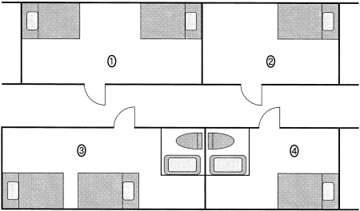

問1 Which room does the woman decide to take?

Slide 4
問1 正解 ③
M: Here’s the dormitory floor plan.
W: I’d like a room with a bathroom.
M: Then, how about this one? It’s for two students, though.
W: I don’t mind that. I’ll take it.

Slide 5
問2 How much did the boy spend on transportation?
① ＄5
② ＄10
③ ＄15
④ ＄25

Slide 6
問2 正解 ①
W: What did you do with your $50, Bobby?
M: Well, Mom, I bought shoes for 35 and spent 10 on Sally’s present.
W: And the rest?
M: I used it for bus fare.

Slide 7
問3 What will the man do today?
① Go to Jim’s house.
② Go to the doctor.
③ Go to the mountains.
④ Go to work.

Slide 8
問3 正解 ④
W: It’s too hot to stay home. Let’s go to the mountains.
M: Sounds great, but Jim’s called in sick.
W: So?
M: I’ve got to go to the office and fill in for him.

Slide 9
問4 What is the one thing the woman did NOT like about the movie?
① The length
② The performances
③ The special effects
④ The story

Slide 10
問4 正解 ①
M: That was a great movie!
W: Yeah, the special effects were cool.
M: I really liked the story and the acting.
W: Me, too. But the movie could’ve been a bit shorter.

Slide 11
問5 How many junk mail messages does the man usually get a day?
① About 30
② About 60
③ About 90
④ About 120

Slide 12
問5 正解 ①
W: How many emails do you usually get a day?
M: Around 90.
W: That many?
M: Yeah, but a third of them are junk mail.

Slide 13
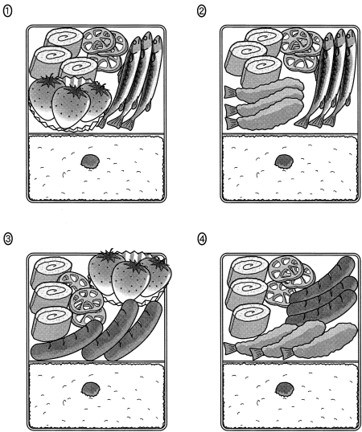
問6 Which is the woman’s lunch?

Slide 14
問6 正解 ④
M: Your lunch looks good.
W: Yeah, but yours looks better. It has strawberries.
M: Do you want one? I’ll trade a strawberry for one of your sausages.
W: That would be nice.

Slide 15
問７～１３は、それぞれの問いについて対話を聞き、最後の発言に対する相手の応答として最も適切なものを、四つの選択肢（①～④）のうちから一つずつ選びなさい。

Slide 16
問7
① Can I go instead of you?
② Can’t you come?
③ Shall I go for it?
④ Would you like to look?

Slide 17
問7 正解 ②
W: I’m looking forward to your dance performance tomorrow night. It starts at 7 o’clock, doesn’t it?
M: Actually, it starts at 5.
W: Oh, I didn’t know that.

Slide 18
問8
① Are most couples like that?
② Do you think so?
③ Don’t mention it.
④ I’m not surprised, either.

Slide 19
問8 正解 ②
W: Did you understand what that couple was saying in Spanish?
M: Well, almost all of it.
W: I’m impressed! Your Spanish seems quite advanced.

Slide 20
問9
① For sure.
② I fell down.
③ It will be.
④ Too bad.

Slide 21
問9 正解 ①
W: I twisted my neck in P.E. class, and it really hurts.
M: Oh, no. Maybe you should leave school early to see a doctor.
W: Would you do that?

Slide 22
問10
① Haven’t you seen him before?
② How did you forget about me?
③ I think you may be mistaken.
④ You have the wrong number.

Slide 23
問10 正解 ③
M: Oh! What a surprise! It’s so good to see you. How have you been?
W: Ah, hello….
M: Don’t you remember me? I’m Joe, from Chicago.

Slide 24
問11
① I don’t, but I know I should.
② No thanks. I’m not thirsty.
③ We ought to sell two liters a day.
④ Yes, my backpack is waterproof.

Slide 25
問11 正解 ①
W: Do you keep anything ready for emergencies?
M: Let me think. I have a flashlight, gloves, and um…, some towels in my backpack.
W: What about water?

Slide 26
問12
① Could you please apply on your own?
② I was hoping you could recommend me.
③ Would you mind signing up for my class?
④ You had better complete your application.

Slide 27
問12 正解 ②
W: Matthew, you wanted to ask me something?
M: Yes, Professor Jones. I’m applying to this university in New Zealand.
W: Wonderful! How can I help you with that?

Slide 28
問13
① Well, the latest ad can be trusted.
② Well, the product sells well worldwide.
③ Well, the questions may be biased.
④ Well, the research seems accurate.

Slide 29
問13 正解 ③
M: Look! This advertisement says that more than 98% of users like this new product.
W: To be honest, I’m generally skeptical about ads like that.
M: Why? It’s based on a survey.

Slide 30
問14 Why did the woman get angry with her son?
① He fell in a hole.
② He missed the train.
③ He tore his pants.
④ He was late for school.

Slide 31
問14 正解 ③
W: I can’t believe it!
M: What, Mom?
W: That hole in your new trousers!
M: I slipped and fell at the station.
W: How many times have I told you not to run there?
M: But I didn’t want to miss the train and be late for school.
W: Anyway, I’m not buying you another pair.

Slide 32
問15 On what day does this conversation take place?
① Monday
② Tuesday
③ Wednesday
④ Thursday

Slide 33
問15 正解 ②
M: Happy Teeth Dental Clinic. How may I help you?
W: I’d like to get my teeth checked.
M: OK. The earliest available time is tomorrow afternoon at 2 o’clock.
W: How about the day after tomorrow at 3?
M: We’re closed on Thursday afternoons, I’m afraid.
W: Oh…, then, what about Thursday morning?

Slide 34
問16 Where is each person now?
① At a health food store and at a supermarket
② At a health food store and at an organic farm
③ At home and at a supermarket
④ At home and at an organic restaurant

Slide 35
問16 正解 ③
W: Hello?
M: Hi, Jennie. I’ve got the milk and yogurt in my shopping cart. What else do we need?
W: Hang on. Let me look in the kitchen.
M: OK.
W: Um…. Will you get some carrots? And make sure they’re organic.
M: Organic? Aren’t they more expensive?
W: A little bit, but it’s worth it.

Slide 36

対話の場面 二人の学生が掲示板のポスターを見ながら，どのプログラムに応募するかを話しています。
問17 Which program does the woman refer to first in the conversation?
① The one in Bolivia
② The one in Brazil
③ The one in Indonesia
④ The one in Portugal
問18 Which country is the man most likely to apply to go to?
① Australia ② Bolivia
③ Indonesia ④ Poland
問19 Which activity is the woman most likely to do?
① Dig wells.
② Produce a festival.
③ Restore a castle.
④ Teach Japanese.

Slide 37
問17 正解 ③ 問18 正解 ① 問19 正解 ③
M: Have you decided which program to apply for?
W: This one looks really exciting. My brother did something similar in Brazil and Mexico. He helped organize events there without knowing Portuguese or Spanish.
M: Well, you would be a good leader, too.
W: Thanks, but there’s a problem with the dates. I can’t really go before mid-July.
M: How about this one? That’s what I’d like to do.
W: Yeah, it looks good. But I have no teaching experience.
M: Well, I’m pretty lucky. I’ve been teaching foreign students as a volunteer for two years.
W: That’s great!
M: This program would be a good chance to learn about the local history, and it doesn’t start till early August.
W: Right, and it would be exciting to gain some new skills.
M: Look! Here’s one that starts at the end of July, and it really helps the local people.
W: Actually, I don’t think I can lift heavy things.

Slide 38
問20 What caused Wilson’s blindness?
① A childhood accident
② A lack of vitamins
③ A sports injury
④ An eye disease
問21 Why did blindness in Africa shock Wilson?
① It was caused by drugs.
② Literacy might have been reduced.
③ Most cases were preventable.
④ There was no known cure.
問22 Which of the following did Wilson’s organization do in Africa?
① It built hospitals for thousands of people.
② It carried out several million eye surgeries.
③ It discovered a new drug in 1960.
④ It reduced blindness by ten percent.

Slide 39
問20 正解 ① 問21 正解 ③ 問22 正解 ②
John Wilson was an Englishman who worked to prevent blindness in the developing world. When he was 12 years old, he was blinded in both eyes during an experiment in science class. After that, he went to a school for the blind where he learned Braille, which is the writing system for people who can’t see. Then he studied law at Oxford University.
After Wilson graduated, he went to Africa. There, he was shocked to find widespread blindness not caused by accidents, as in his own case, but resulting from the lack of effective treatment for certain diseases. For decades, he led an organization to prevent such blindness in Africa through education, research, and health care. For example, a disease spread by insects blinded 10 % of the people in a part of Ghana, but in the 1950s, his organization distributed a drug that nearly eliminated the disease by 1960. In addition, it helped reduce the number of blind children by giving out vitamins and also by performing over three million eye operations. As a result, millions of people who were in danger of becoming blind have been treated, and blindness is less common there now.

Slide 40
会話の場面 英語の授業で, Eiji, Tomomi, Asakoがアメリカへ持っていく手土産について話し合いをしています。
問23 Which of the following does Tomomi suggest buying?
① Expensive gifts
② Practical gifts
③ Seasonal gifts
④ Traditional gifts
問24 Which of the following does Eiji suggest buying?
① Japanese paintings
② Japanese pottery
③ Japanese stationery
④ Japanese sweets
問25 What gifts do they decide on?
① Kimonos, chopsticks, and fans
② Pencils, notebooks, and comic books
③ Pens, erasers, and folders
④ Staplers, bowls, and picture books

Slide 41
問23 正解 ② 問24 正解 ② 問25 正解 ③
Eiji: OK. The teacher asked us to discuss gifts to take to our sister school in the US. What kind of gifts do you think we should take, Tomomi?Tomomi: Hmm, what about stationery? I’ve heard that lots of Americans really like Japanese stationery because there are a lot of cool and useful items. Some have cute cartoon characters on them. Even functional and practical things like pens, staplers, and notebooks have cool designs that might not be available in the US. Yeah, I think stuff like that would be good because it’s small, light, and easy to carry.
Eiji: That’s a good idea, Tomomi, but don’t you think something more traditional would be better―like a kimono? Well, maybe not a kimono because that would be too expensive. But what about chopsticks or fans? Oh, I know. How about ceramic bowls, vases, and those kinds of things? I’ve seen them for sale in tourist areas, and they seem really popular. Some have pictures of carp, cherry blossoms, or maple leaves on them. Yeah, I think we should take something like that. What do you think, Asako?
Asako: Me? Well, I agree that our presents should reflect Japanese culture. But that kind of traditional stuff you mentioned might be better for older people. I’ve heard that some American teenagers these days are crazy about Japanese pop culture, especially anime and manga. I like Tomomi’s idea of taking pens, but how about adding some folders with popular manga or anime characters on them and some cute erasers? Pottery would be too heavy, but stationery is easy to pack and carry. I’m sure everyone would love it. Oh, maybe not the teachers, though. Let’s just get them nice stationery items with traditional designs.
Eiji: Brilliant! Those are really good points, Asako.
Tomomi: OK. It’s settled then. Let’s go with those ideas!

