Slide 1
センター2017追試 リスニング

Slide 2
第1問は問1から問6までの6問です。それぞれの問いについて対話を聞き、答えとして最も適切なものを、四つの選択肢(①~④)のうちから一つずつ選びなさい。

Slide 3
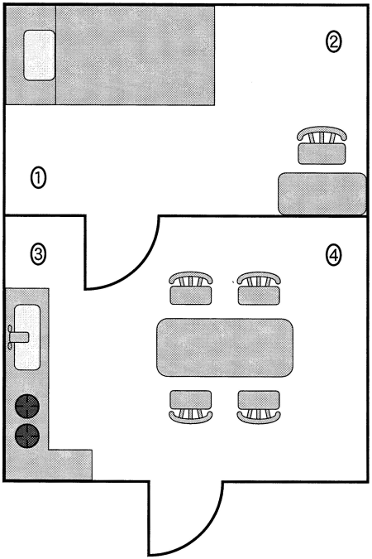
問1 Where does the woman want to put the plant?

Slide 4
問1 正解 ③
M: Look, Katie. I just bought you this plant.
W: Lovely. It’ll look nice in the corner by the door.
M: Do you mean beside the bed?
W: No, by the sink.

Slide 5
問2 How much did the man earn this month?
① $50
② $80
③ $300
④ $400

Slide 6
問2 正解 ③
W: So, Kenny, how much do you get paid?
M: Fifty dollars a day.
W: How many days a month do you work?
M: Normally eight. But this month I took two days off.

Slide 7
問3 What did the boy say he would do first?
① Clean his room.
② Do homework.
③ Fill out the application.
④ Watch television.

Slide 8
問3 正解 ①
W: You look tired. Too much homework?
M: No, Mom. I stayed up late watching TV.
W: You also have your college application to fill out.
M: I’ll do it after cleaning my room.

Slide 9
問4 What do the two speakers agree on about the painting?
① It has a beautiful frame.
② It has nice colors.
③ It is difficult to understand.
④ It is hard to paint.

Slide 10
問4 正解 ②
M: That’s a beautiful painting.
W: Really? I have no idea what it means.
M: You don’t? Well, anyway, the colors are wonderful.
W: True, but the painting’s too abstract for me.

Slide 11
問5 How old is the girl now?
① 7
② 10
③ 14
④ 17

Slide 12
問5 正解 ④
M: I’m really enjoying the festival.
W: I’m glad. It’s held only once every seven years. Actually, I participated in the parade the last time.
M: Really? How old were you then?
W: Ten.

Slide 13
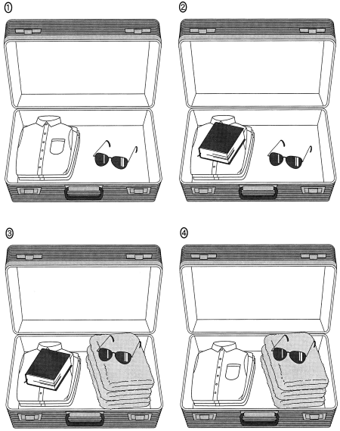
問6 What does the man’s suitcase look like now?

Slide 14
問6 正解 ④
W: Have you finished packing?
M: Not quite. I’ve got clothes, sunglasses, towels….
W: Doesn’t the hotel provide towels?
M: These are for the beach. Oh, I still have to get my book.

Slide 15
問７～１３は、それぞれの問いについて対話を聞き、最後の発言に対する相手の応答として最も適切なものを、四つの選択肢（①～④）のうちから一つずつ選びなさい。

Slide 16
問7
① Yeah, everybody uses email instead.
② Yeah, I wrote a letter yesterday.
③ Yeah, letters are delivered once a day.
④ Yeah, Uncle John rarely sends emails.

Slide 17
問7 正解 ①
W: Did you write a letter to your Uncle John?
M: No, but I sent an email. Grandma, nobody writes letters anymore.
W: Really? Is that so?

Slide 18
問8
① But we celebrate annually.
② But we went to one last time.
③ I will look around the restaurant.
④ I would prefer making it online.

Slide 19
問8 正解 ②
W: You’ve been on the computer for a long time tonight.
M: I’m trying to find a restaurant for our anniversary dinner.
W: How about an Italian place?

Slide 20
問9
① She failed to make a sign.
② She probably came here.
③ She should be right back.
④ She’s already gotten rid of it.

Slide 21
問9 正解 ③
W: So, where’s the boss?
M: I don’t know. She was just here.
W: I need to get her signature on this form.

Slide 22
問10
① Oh, I’ll let you know if I can.
② So, have you ever played over there?
③ Sure, why don’t you give it a try?
④ Then, I’ll be wondering about it.

Slide 23
問10 正解 ①
M: Carol, are you free this weekend?
W: Maybe. How come?
M: I’m going to see a play at the new theater on Saturday night, and I was wondering if you can come.

Slide 24
問11
① Well, I have a technical problem.
② Well, I haven’t typed very often.
③ Well, let me give you some tips.
④ Well, tell me how you like it.

Slide 25
問11 正解 ③
M: Amazing! I can’t believe how fast you can type.
W: I’ve been doing it almost every day since high school.
M: I’ve been trying to improve my typing speed, but it’s difficult.

Slide 26
問12
① Oh, I don’t even want to try it once.
② Oh, I was going to say it was good.
③ Oh, you didn’t think it was weird.
④ Oh, you should have had it sometime.

Slide 27
問12 正解 ②
W: Did you try natto while you were in Japan?
M: Yes, it tasted so…
W: So strange! It smells kind of nasty as well.

Slide 28
問13
① Didn’t they leave about two hours ago?
② I don’t think so. They’ve just gone.
③ Weren’t they planning to leave tomorrow?
④ You’re right. They haven’t departed yet.

Slide 29
問13 正解 ③
M: Are you coming to the party tonight?
W: Yeah. I can’t wait to see Susan and Chris there.
M: Ah, I’m afraid they’ve already left for Brazil.

Slide 30
問14 What is one thing that the pamphlet recommends?
① Don’t do excessive exercise.
② Don’t raise the humidity inside.
③ Take a cold bath or shower.
④ Use plenty of sunblock lotion.

Slide 31
問14 正解 ①
M: This pamphlet explains why summer heat can be dangerous to our health.
W: What does it say?
M: The biggest problem is high humidity.
W: Why’s that?
M: It makes it hard for the body to cool down.
W: What does it say we can do?
M: Avoid exercising too much, and drink plenty of water.

Slide 32
問15 What are they trying to decide?
① What to do while waiting
② When to have a meal
③ Where to take a nap
④ Which flight to take

Slide 33
問15 正解 ①
W: Another delay?
M: Yeah, till 2:45. But they didn’t say why the flight is delayed.
W: How are we going to kill time?
M: Drink some coffee?
W: If I have any more, I won’t be able to sleep tonight.
M: Eat something?
W: We’ve just had lunch.
M: How about something sweet, like cheesecake?
W: Well….

Slide 34
問16 What is the man going to take out today?
① Cans and glass
② Cans and plastics
③ Paper and glass
④ Paper and plastics

Slide 35
問16 正解 ①
W: Could you take out the garbage?
M: Sure. Which kind? I see cans, paper, plastics, and glass.
W: Well, it’s the second Saturday today. So everything except plastics.
M: But didn’t you say the collection schedule had been changed?
W: Oh, yeah. Let me check…. Oh, don’t take the paper, either.

Slide 36
対話の場面 日本の大学に通う二人の学生が掲示板のポスターを見ながら，どのコースに応募するかを話しています。
問17 Which country is the woman most likely to apply to go to?
① Canada ② Malaysia
③ Switzerland ④ Thailand
問18 Which country is the man most likely to apply to go to?
① Canada ② Malaysia
③ Switzerland ④ Thailand
問19 Which three factors are mentioned in their conversation?
① Activity, climate, and length
② Activity, language, and location
③ Language, climate, and length
④ Language, length, and location

Slide 37
問17 正解 ① 問18 正解 ② 問19 正解 ②
W: These courses look great, don’t they?
M: Yeah! They all offer the chance to learn a foreign language and focus on other things, too.
W: Oh, I like this one. I could practice my ball-handling and improve my French.
M: Right. Or, with this one, you could climb mountains and learn German.
W: Here’s one that focuses on photography. It looks like it’d be nature photography, especially animals.
M: That sounds really exciting. Look, here’s one where you can learn ethnic dance. That appeals to me, too, and it’s closer to Japan.
W: I don’t mind going farther away, especially if it’s cool in summer.
M: Then, that means mountain climbing or basketball.
W: I don’t think I’m ready to start another foreign language. So I guess I’ll stick with my first idea. How about you?
M: I want to try something challenging. And I like the heat and nature, so I think I’ll go for that one.

Slide 38
問20 What was George Ferris’s occupation?
① Civil engineer
② Construction worker
③ Event planner
④ Interior designer
問21 What was one of the reasons the organizers did not like Ferris’s proposal?
① It was not as good as the Eiffel Tower.
② It was too similar to other ideas.
③ It would be too expensive to build.
④ It would not be memorable.
問22 Which of the following would be the best title for this lecture?
① Famous American Inventors
② Ferris Wheels Around the World
③ The Father of the Ferris Wheel
④ The Promotion of World’s Fairs

Slide 39
問20 正解 ① 問21 正解 ③ 問22 正解 ③
A popular ride at many amusement parks is the Ferris wheel, a giant vertical wheel with seats giving passengers great panoramic views. It was named after its American inventor, George Ferris. Ferris was born in Illinois in 1859. He studied civil engineering, and he became well known for building and designing railroads, bridges, and tunnels. What he is mainly remembered for, however, is his attempt to design something more impressive than France’s Eiffel Tower.
In the 1889 World’s Fair in Paris, the Eiffel Tower was considered a technological masterpiece. The next World’s Fair was to be held four years later in Chicago, and the organizers asked engineers to think of exciting ideas that would make their fair memorable.
Ferris proposed a 76-meter-high steel wheel with 36 cars; that could each hold 60 people. His proposal was rejected originally because the organizers thought it was dangerous, costly, and unrealistic. However, he proved that it would be safe and raised money to build it. Then, his proposal was approved, and the wheel was built. During the fair, about 10,000 people rode it daily. Unfortunately, Ferris died soon after the fair ended. Nevertheless, his name lives on today in many amusement parks around the world.

Slide 40
会話の場面 同じマンションに住んでいるMaria, David, Hannahが，マンションでペットを飼う際の決まりについて話し合いをしています。
問23 What was David’s first suggestion?
① A list of dangerous animals should be made.
② Even large snakes should be permitted.
③ Most little pets should be accepted.
④ Only a small number of pets should be allowed.
問24 What do Hannah and Maria agree on?
① Neither elevator should be used for pets,
② Noise and pet size may not be related.
③ Older people prefer to keep quiet pets.
④ Pet owners should live on lower floors.
問25 What is their next step?
① Decide on the residents’ meeting date.
② Limit the sizes and types of pets.
③ Present their ideas at a meeting.
④ Put signs on the elevators.

Slide 41
問23 正解 ③ 問24 正解 ② 問25 正解 ③
Maria: OK, so next, let’s talk about what kinds of pets should be allowed. What if someone wants to keep something dangerous, like a snake or a monkey? What do you think, David?
David: I’m not sure how many people would want to keep monkeys, Maria, but it’s a good idea to make a list of acceptable pets. In principle, I think most small pets, especially those in cages, like hamsters, turtles, birds…or even snakes, should be allowed. Most snakes aren’t poisonous anyway. The main thing is that the pets should be small, especially dogs. Big dogs could cause trouble. What if they bite someone? What if they’re noisy? Don’t you agree, Hannah?
Hannah: Well, David, I agree that we shouldn’t allow any dangerous animals in the building, but I don’t think they have to be small. Big dogs aren’t necessarily noisier than small ones. My grandmother has a small dog that barks all the time. Some big dogs are very calm and quiet.
Maria: Yeah, that’s true. But I’m worried that people will complain about pets in the elevators, especially if they’re afraid of animals. Or, if they have allergies, like me. I’m allergic to dogs. Actually, pet owners should probably use the stairs.
Hannah: Well, I live on the 10th floor. I don’t think we can ask pet owners to climb the stairs above the third floor.
Maria: Oh yeah. Sorry. I didn’t think of that. Oh! There’re two elevators. Pets could be allowed in one, but not the other. We could put signs for one elevator that say No Pets Allowed.
David: I like that idea. That would be easy to do. So, we’ll take our ideas to the residents’ meeting tomorrow and see what everyone else says.
Hannah: Sounds good. But it might be hard to get everyone to agree.

