Slide 1
センター2018本試 リスニング

Slide 2
第1問は問1から問6までの6問です。それぞれの問いについて対話を聞き、答えとして最も適切なものを、四つの選択肢(①~④)のうちから一つずつ選びなさい。

Slide 3
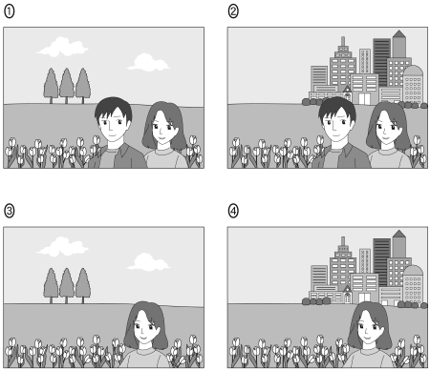
問1 Which picture are they looking at?

Slide 4
問1 正解 ②
M: Look! This picture is from last spring.
W: What a beautiful garden!
M: Amazing, isn’t it? And the skyscrapers in the distance.
W: Uh-huh. By the way, who’s the woman beside you?

Slide 5
問2 How much of their own money will each person pay?
① １０ dollars
② １５ dollars
③ ３０ dollars
④ ３５ dollars

Slide 6
問2 正解 ③
W: Our bill is 85 dollars.
M: I have a fifteen-dollar discount coupon.
W: Remember, Mom gave us ten dollars. Let’s use that as well.
M: OK, and then we can split the rest.

Slide 7
問3 What does the woman say about her new job?
① Employees are free on weekends.
② It takes too much time to get to work.
③ She gets along with her colleagues.
④ The boss is often away on business.

Slide 8
問3 正解 ③
M: How’s your new job?
W: Well, my boss is OK, and I don’t spend much time commuting.
M: But I’ve heard you often work weekends.
W: Still, I enjoy being with my co-workers.

Slide 9
問4 What will the man do?
① Get a new model later.
② Get a new model now.
③ Get an old model later.
④ Get an old model now.

Slide 10
問4 正解 ③
W: Our shop recommends this new phone.
M: Is there anything cheaper?
W: The earlier model’s out of stock but will arrive soon. It’s half the price.
M: Could you hold one for me?

Slide 11
問5 What time did the woman think it was?
① １:２０
② １:３０
③ １:４０
④ １:５０

Slide 12
問5 正解 ②
M: Let’s go! The meeting will start soon.
W: We still have plenty of time. Doesn’t the meeting start at 2?
M: Yeah, in ten minutes.
W: Oh, no! My watch is 20 minutes behind.

Slide 13
問6 Which graph describes what they are talking about?

Slide 14
問6 正解 ②
W: Our survey shows the number of foreigners visiting our museum has been decreasing.
M: Especially from Europe.
W: But the number from Asia is on the rise.
M: At least that’s good news.

Slide 15
問７～１３は、それぞれの問いについて対話を聞き、最後の発言に対する相手の応答として最も適切なものを、四つの選択肢（①～④）のうちから一つずつ選びなさい。

Slide 16
問7
① Oh, I forgot to go shopping.
② Oh, you should’ve reminded me.
③ Sure, anything but batteries.
④ Sure, the shop by the station.

Slide 17
問7 正解 ②
W: Ah, Marcos, there you are.
M: I just came back from the store.
W: Did you get everything? How about the batteries?

Slide 18
問8
① OK, don’t you have any?
② OK, give me another minute.
③ OK, is it your second time here?
④ OK, you can ask which is which.

Slide 19
問8 正解 ②
M: Ready to order?
W: No, not yet. Do you have any vegetarian meals?
M: They’re on the second to the last page.

Slide 20
問9
① Sure, they won the contest.
② What if you were?
③ Why don’t they try?
④ You’re not the only one.

Slide 21
問9 正解 ④
M: What did you think of the drawing contest?
W: To be honest, I’m kind of surprised Hiroshi won.
M: Right. I thought Ayako had a good chance.

Slide 22
問10
① Oh, I didn’t know any of them.
② Oh, you can tell others.
③ Umm, they are not fast enough.
④ Umm, we could look it up.

Slide 23
問10 正解 ④
W: Grandpa, which runs faster, a lion or a tiger?
M: Well, which do you think is faster, Patty?
W: I’m asking because I don’t know.

Slide 24
問11
① Right, for the time being.
② Right, forty on white.
③ Well, let me choose white.
④ Well, the other way around.

Slide 25
問11 正解 ④
M: Jane, how many copies do we need?
W: Twenty copies on white paper and twice as many on pink.
M: OK, 20 on pink and 40 on white.

Slide 26
問12
① I think the class is pleasant.
② I’m not really worried that much.
③ Luckily, there were no maps on the test.
④ Whatever grade you were in.

Slide 27
問12 正解 ②
W: So, how was your geography class this term?
M: All right, Mom. It was fun, and I do like maps.
W: Do you think you’ll get a good grade?

Slide 28
問13
① Did I?
② Did it?
③ Did we?
④ Did you?

Slide 29
問13 正解 ①
W: Morning, Steve. Is something wrong?
M: I changed my computer password. Now I can’t remember it.
W: I think you told me yesterday you’d changed it back to what it was before.

Slide 30
問14 What will they do about dinner?
① They’ll eat curry at a restaurant.
② They’ll eat curry at home.
③ They’ll eat fried rice at a restaurant.
④ They’ll eat fried rice at home.

Slide 31
問14 正解 ②
W: What’s for dinner tonight, Dad?
M: Hmm, we have vegetables in the fridge for fried rice.
W: You’re not going shopping? Then let’s eat out.
M: It’s pouring outside. I’d rather stay home.
W: What about the restaurant around the corner? I feel like curry.
M: OK, they deliver, and I won’t need to cook.

Slide 32
問15 How long can a person extend online?
① One week
② Two weeks
③ Three weeks
④ Four weeks

Slide 33
問15 正解 ①
M: How many books can I borrow from the library?
W: Up to four at a time.
M: For how long?
W: Two weeks, but you can extend the period a week at a time if no one has requested the book.
M: Can I do it online?
W: Sure, but only once for online extensions.

Slide 34
問16 What will the man find out about his neighbor?
① How long he has been a doctor
② What hospital he works at
③ When he started the volunteer work
④ Who he volunteers for

Slide 35
問16 正解 ③
W: Did you do the homework about interviewing someone you admire?
M: Yes. Who did you interview?
W: My aunt. She’s a doctor. How about you?
M: My neighbor. He volunteers at an animal shelter.
W: Good for him! How long has he been doing that?
M: Oh, I’ll have to ask him.

Slide 36
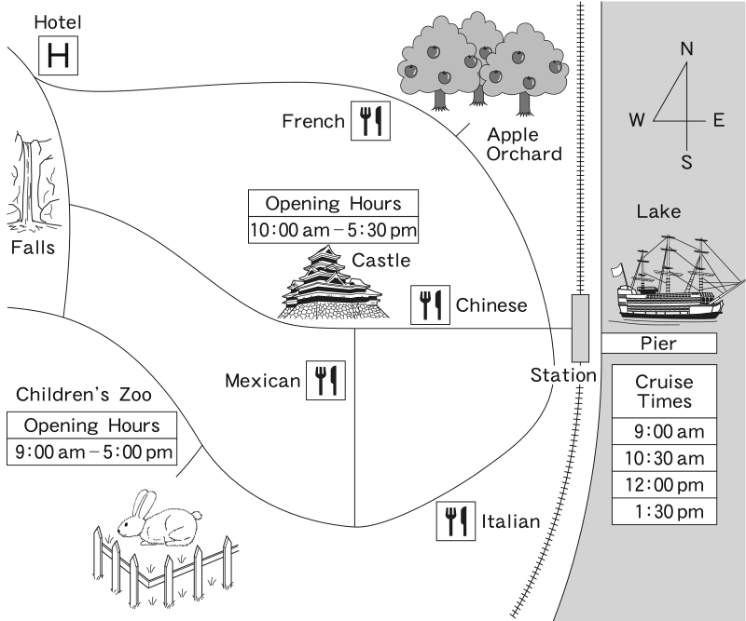
対話の場面 夫婦が駅前で地図を見ながら今日と明日の観光の予定について話をしています。
問17 Which cruise are they most likely going to take?
① ９:００am ② １０:３０am
③ １２:００pm ④ １:３０pm
問18 Which restaurant are they going to go to for lunch?
① The Chinese restaurant
② The French restaurant
③ The Italian restaurant
④ The Mexican restaurant
問19 What places are they planning to go to tomorrow?
① The castle and the children’s zoo
② The castle and the falls
③ The children’s zoo and the orchard
④ The falls and the orchard

Slide 37
問17 正解 ② 問18 正解 ④ 問19 正解 ②
M: OK, how about a cruise first?
W: Sounds great! It lasts an hour, so we could have lunch after that.
M: This restaurant looks good. It’s probably 30 minutes or so from the pier. If we leave right after the cruise, we can get there around noon.
W: Perfect! There’s a castle just north of it. What do you think?
M: Yeah…, I was hoping we could take the kids here to feed the rabbits before heading to the hotel.
W: OK, let’s visit the castle tomorrow, then.
M: All right. Oh, there’s apple picking. Hmm, it’s a shame it’s too early in the year.
W: Don’t forget, we need to be at the hotel by 5:30 for dinner.
M: Right. Look! How about stopping here? It’s on the way from the zoo to the hotel. We could take our annual family photo there.
W: Maybe that’s too much for one day.
M: I suppose…. Let’s do that tomorrow afternoon.

Slide 38
問20 What bothered the speaker about cleaning?
① Following instructions
② Returning before 10 pm
③ Sweeping the floor
④ Waking up early
問21 What was the speaker’s opinion about phones in the dormitory?
① Mobile phones should have been allowed.
② Mobile phones should have been cheaper.
③ Phones should have been placed in each room.
④ Phones should have been placed on each floor.
問22 Which of the following would be the best title for this story?
① How I challenged the strict Japanese dorm system
② How I improved the rules of a Japanese dorm
③ How I matured while living in a Japanese dorm
④ How I survived a Japanese dorm without a phone

Slide 39
問20 正解 ④ 問21 正解 ④ 問22 正解 ③
When I was an exchange student in Japan over 20 years ago, I lived in a dormitory. It was an unforgettable, transforming experience. Several, things bothered me during that time, though. Learning Japanese, performing dorm duties, and obeying dorm rules were especially troublesome. For example, there was a curfew, which meant we had to return no later than 10 in the evening. One of the duties was cleaning the floors and the bathroom. I wouldn’t have minded, but it had to be done before everyone else got up.
Telephone duty was another annoying responsibility. Mobile phones weren’t available back then. Amazingly, the only phone was on the first floor, and we took turns answering it. I knew having a phone in each room was too costly, but surely a phone on each floor would’ve been reasonable. Many of these duties and rules felt like burdens to me. Although it was a huge challenge communicating in a foreign language and dealing with these obstacles, it turned out to be beneficial for me. It forced me to improve my language ability and adapt very quickly. I realize now that overcoming these difficulties helped me grow up and become a more responsible person.

Slide 40
会話の場面 大学生のTokiko, Justin, Karen が国際交流センターで話し合いをしています。
問23 What is Justin most concerned about?
① Academic preparations
② Cultural aspects
③ Personal safety
④ Travel arrangements
問24 What is Tokiko’s advice regarding what to pack?
① Bring enough money to last the trip.
② Consider the climate of your destination.
③ Make sure your suitcases are not too heavy.
④ Take a journal to write about experiences.
問25 Which of the following best describes the conversation?
① They all shared personal episodes.
② They came to a definite conclusion.
③ They debated the value of studying abroad.
④ They each emphasized a different point.

Slide 41
問23 正解 ④ 問24 正解 ② 問25 正解 ④
Tokiko : Thanks for coming to the meeting. The international programs office has asked us to put together a booklet for students going abroad. Since all of us have studied abroad, they think our suggestions will help other students get ready. Justin, what do you think we should include?
Justin : Well, Tokiko, we need to focus on practical items first. For instance, sometimes it takes a while to get passports and visas. We could suggest they start that process early. Also, they’ll need a health check and travel insurance. Karen, did you have something to add?
Karen : Yeah, I’m thinking about cultural aspects. Don’t they need to know some history or study about the society and learn the local customs long before they leave? Maybe they should consider these things in order to choose a country of destination.
Tokiko : That’s right, Karen. Preparing to live there has to come first. Also, what they pack in their suitcases depends a lot on where they go. That’s a really fun part―deciding what to take. In my experience I was glad I took light clothing I could wear in layers, rather than heavy, winter clothes.
Justin : OK, but there are still other things to do before you actually pack. What about airline tickets? Getting tickets early can save money, and there’ll be more choices of dates. So I think that also needs to be on the list.
Karen : That’s true, Justin, but you really shouldn’t buy tickets until you’re sure you have permission to live there…. Oh, I know what else we could do! Maybe we can include short essays or personal stories about our experiences and host families. It might help students get mentally prepared.
Tokiko : That’s an option…. Well, we’re getting there, but we still have a long way to go.

