Slide 1
センター2018追試 リスニング

Slide 2
第1問は問1から問6までの6問です。それぞれの問いについて対話を聞き、答えとして最も適切なものを、四つの選択肢(①~④)のうちから一つずつ選びなさい。

Slide 3
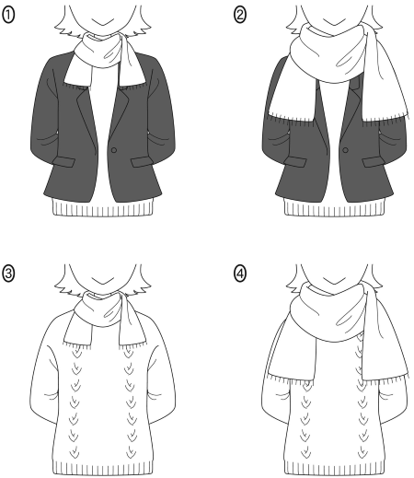
問1 How is the woman dressed?

Slide 4
問1 正解 ④
M: It’s cold today.
W: Yeah, it’s freezing! I should’ve worn a jacket.
M: But you’ve got a big scarf wrapped around your neck.
W: I know, but I’m still cold.

Slide 5
問2 How many points will the customer get?
① ２０
② ４０
③ ８０
④ １００

Slide 6
問2 正解 ③
M: How many points will I get for this purchase?
W: Ten points for every thousand yen, and your total’s 4,000 yen….
M: And, today’s Tuesday, so I get double points?
W: Right.

Slide 7
問3 Where did Nick finish in the tournament?
① In first place
② In second place
③ In third place
④ In fourth place

Slide 8
問3 正解 ②
W: How was the tennis tournament, Nick?
M: I made it to the finals, but in the third set, it started raining.
W: And then?
M: I lost my concentration and that was it.

Slide 9
問4 What disappointed the man about the concert?
① The band arrived very late.
② The band didn’t perform their newest song.
③ The band didn’t play long enough.
④ The band had a new guitarist.

Slide 10
問4 正解 ②
W: What a fantastic concert!
M: Well, the band was OK….
W: The new guitarist was awesome! And they played for a long time!
M: Yeah, but I wish they’d played their latest song.

Slide 11
問5 How many pills does the man have to take each day?
① Three
② Five
③ Seven
④ Nine

Slide 12
問5 正解 ③
W: The doctor gave you three kinds of pills for five days.
M: OK.
W: Take one each of these two, three times a day.
M: And the other one?
W: One after dinner.

Slide 13
問6 Which graph describes what they are talking about?

Slide 14
問6 正解 ②
W: In April, monthly sales decreased from March.
M: Yes, but they increased in May.
W: Interesting. Sales usually decline in May.
M: I guess our sales campaign worked.

Slide 15
問７～１３は、それぞれの問いについて対話を聞き、最後の発言に対する相手の応答として最も適切なものを、四つの選択肢（①～④）のうちから一つずつ選びなさい。

Slide 16
問7
① Can you throw it back?
② I appreciate it.
③ Over where?
④ You can’t miss it.

Slide 17
問7 正解 ③
M: Excuse me. Can you toss that ball back to us?
W: Sorry, I don’t see it.
M: It’s right over there, under that tree.

Slide 18
問8
① How big is big?
② It’s pretty good so far.
③ Please give it a try.
④ Why wouldn’t you refuse?

Slide 19
問8 正解 ①
M: Say, Erika! I’ve got something for your new apartment.
W: Really, Dad? What?
M: Well, how would you like a big, new sofa?

Slide 20
問9
① Yes, and my elbow, too.
② Yes, but near my house.
③ Yes, I happened to run for it.
④ Yes, it must be painful.

Slide 21
問9 正解 ①
W: Hey, what happened to you?
M: Oh, I fell off my bike when I hit a bump.
W: Is that why your wrist is swollen?

Slide 22
問10
① Do you still have your receipt?
② I haven’t shown it to you before.
③ No, I don’t have one like that.
④ What about changing the battery?

Slide 23
問10 正解 ①
W: Oh, no! I can’t believe it. My watch strap broke.
M: Isn’t that the one you just bought?
W: And it was such nice leather!

Slide 24
問11
① I didn’t know you’d cut your stay short.
② I didn’t mean to surprise you.
③ I didn’t plan to stay for many years.
④ I didn’t realize you’d left for Sweden.

Slide 25
問11 正解 ①
M: Happy New Year, Aki! Long time no see.
W: Wow, Paul! When did you come back from Sweden?
M: Ha, ha! I’m the last person you expected to see, right?

Slide 26
問12
① It appears disappointing.
② It doesn’t excuse me.
③ You had better not.
④ You promise it will.

Slide 27
問12 正解 ③
W: Good morning, sir. I’m sorry I’m late.
M: This can’t keep happening, Nancy.
W: Yeah, I know, I know. I won’t let it happen again.

Slide 28
問13
① Absolutely not. I can’t argue with that.
② Definitely. You can say that again.
③ I agree. I’m firmly against the idea.
④ I disagree. That’s our responsibility.

Slide 29
問13 正解 ②
W: So, Tom, what do you think we can do about current environmental problems?
M: Well, we could start with sustainable development.
W: Good point. We’re wasting a huge amount of energy.

Slide 30
問14 What does the coach say is the highest priority?
① Avoiding injury
② Eating healthy food
③ Exercising daily
④ Getting plenty of sleep

Slide 31
問14 正解 ②
W: Thank you for joining the community baseball team! So, Tomoya, what do we need to do to be strong players?
M: Exercise every day, coach!
W: Good. What else?
M: Get enough sleep? Don’t get hurt?
W: Those are good ideas. But, remember, nothing’s more important than maintaining a nutritious, well-balanced diet.

Slide 32
問15 What will the daughter do next?
① Ask her father to record the movie.
② Ask her father to record the soccer game.
③ Record the movie herself.
④ Record the soccer game herself.

Slide 33
問15 正解 ③
W: Can I change the channel?
M: I’m watching this. You can record your program for later.
W: Oh, Dad. You don’t understand. I need to watch the soccer game. Can I just record this movie for you so you can watch it later?
M: But….
W: Come on, Dad.
M: Oh, OK. Go ahead.

Slide 34
問16 What does the woman want?
① A color change only
② A new haircut and color change
③ A shorter cut but no color change
④ The same cut and no color change

Slide 35
問16 正解 ②
M: What can we do for you today? The usual?
W: I’m tired of the same hairstyle.
M: Hmm…. We could do a shorter cut.
W: Sounds good.
M: And a new color combination.
W: Like how?
M: How about brown, with blue highlights to match your eyes?
W: I don’t see why not.

Slide 36
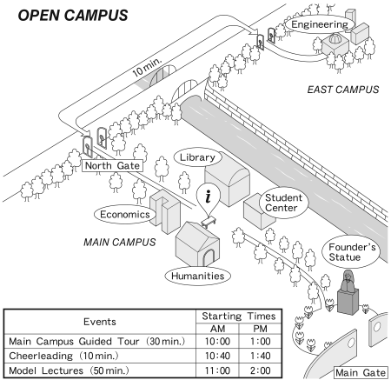
対話の場面 オープンキャンパスのインフォメーションデスク(i)で入学希望者が質問をしています。
問17 What is next on the tour after the School of Humanities?
① Founder’s Statue ② Library
③ School of Economics ④ Student Center
問18 About how long will it take to walk to the East Campus from the information desk?
① ５ minutes ② １０ minutes
③ １５ minutes ④ ２０ minutes
問19 Based on the conversation, what time will the woman finish her campus visit?
① １:３０pm ② １:４０pm
③ １:５０pm ④ ２:００pm

Slide 37
問17 正解 ③ 問18 正解 ③ 問19 正解 ③
W: Hi, is this where the campus tour starts?
M: Yes, there’s one at ten. Here’s the map and timetable.
W: Perfect.
M: You start at the School of Humanities, then visit the other three buildings clockwise. You’ll be back here by 10:30.
W: Uh-huh. And model lectures?
M: Yes, after the tour. Oh, between the tour and lectures, our award-winning cheerleaders perform in front of the statue. And the afternoon schedule is….
W: Ah, but I have to leave by two, so….
M: I see, so what lecture are you interested in?
W: Robot Technology.
M: That’s on the East Campus. You should walk to the School of Engineering right after the tour.
W: Uh, from the North Gate?
M: Right. It’s about 5 minutes from here to the North Gate.
W: Got it. I’ll be back for the performance after lunch.
M: Mind you, it’s at least 10 minutes from the North Gate to the Founder’s Statue.
W: OK.

Slide 38
問20 Why did the speaker work every summer?
① To cover college expenses
② To gain job experience
③ To learn new skills
④ To make connections
問21 Which summer job did the speaker do for the shortest time?
① Assembling furniture
② Copying documents
③ Gathering earthworms
④ Serving in a cafeteria
問22 What is the main message of this story?
① Part-time jobs ruin college days.
② Teamwork brings many pleasures.
③ Paying tuition builds character.
④ Work teaches worthwhile lessons.

Slide 39
問20 正解 ① 問21 正解 ③ 問22 正解 ④
While attending college, I could hardly afford tuition. For this reason, I had to work at the campus cafeteria throughout the school year. Once classes were out, I had to find another job for the summer. Among the summer jobs I tried, three have stood out in my memory. In one, I was hired for a month to build tables and chairs at a factory. It was hard, but by working with others, I learned teamwork. Another job was at a public library. There, I made copies of documents for seven and a half hours each day. Despite the boredom, I developed patience and stamina in my two weeks on the job. A strange job that taught me my physical limits was collecting worms to provide bait for fishing shops. We went to golf courses just before dawn and tried to fill buckets with earthworms. The pay was $10 for each full bucket, but by the end of one week, I had to quit―my back was too sore to continue. Because of my struggles in these jobs, I discovered the value of hard work and gained a new appreciation of how fortunate I was to attend university.

Slide 40
会話の場面 Daniel, Maggie, Kanta の３人が，初めて参加するディベートコンテストに向けて話し合いをしています。
問23 What will Maggie take care of?
① Planning argument strategy
② Preparing memory aids
③ Researching the topic
④ Teaching proper gestures
問24 What did Kanta recommend they do?
① Be serious and wear formal suits.
② Do research and write speeches.
③ Practice well and rest beforehand.
④ Use memory aids and watch videos.
問25 What was the result of this meeting?
① They all decided on a debate topic.
② They each agreed on a way to help.
③ They got less done than expected.
④ They set a time to meet the next day.

Slide 41
問23 正解 ① 問24 正解 ③ 問25 正解 ②
Daniel: OK, how can we prepare for our first debate? Besides researching the topic, I wonder what else we can do. What do you think, Maggie?
Maggie : Well, Daniel, research is important, but I think we have to plan our speeches carefully. We need to predict what the opposing team will say. Then, we need to find smart ways to argue against their positions.
Kanta : Right…. Both kinds of preparation are necessary. So Maggie, why don’t you take care of what you mentioned, and we’ll leave the research up to you, Daniel.
Daniel: Sounds good, Kanta.
Kanta: Great! Uhh…, but, even if we do careful research and come up with counter arguments, I’m thinking we also need to perform well. It’ll take time to memorize and rehearse. I’ll be in charge of making a video of our practices. That way we can check our gestures and voice quality.
Maggie : Are you sure we have to memorize it all, Kanta? Maybe we could make memory aids like index cards. Or, what about some kind of outline with talking points? With that, we can sort the points according to importance. And if we get confused during arguments, we can get back on track quickly.
Daniel: Gee, Maggie, I don’t think it’s a good idea to use those kinds of aids because we won’t sound convincing or look confident. Isn’t that right, Kanta?
Kanta : Yeah, if we practice, get plenty of sleep, and eat a good breakfast, I think our memories will work well enough.
Maggie : All right, that should work. And don’t forget to dress properly. Our score might be lowered if the judges think we’re not serious about the debate.
Daniel: Hey, this is working out better than I expected. So, now we can get down to work and meet again tomorrow.

