Slide 1
センター2019追試 リスニング

Slide 2
第1問は問1から問6までの6問です。それぞれの問いについて対話を聞き、答えとして最も適切なものを、四つの選択肢(①~④)のうちから一つずつ選びなさい。

Slide 3
問1 Which book cover will they use?

Slide 4
問1 正解 ①
M: The title should not be in three lines.
W: OK. And what about the palm trees?
M: Put them on the left rather than on the right.
W: Got it.

Slide 5
問2 What is the capacity of the hall?
① 40 people
② 80 people
③ 120 people
④ 160 people

Slide 6
問2 正解 ③
M: How many people have bought tickets for the event so far?
W: Forty.
M: Really? That’s it? In that huge hall?
W: Yeah. It can hold three times as many people as that.

Slide 7
問3 What problem with the train did the woman report?
① It had an accident.
② It had no announcements.
③ It was delayed.
④ It was full of people.

Slide 8
問3 正解 ③
M: Was your train very crowded?
W: Not at all. But it was way behind schedule.
M: Was there an accident?
W: I don’t know. The announcements didn’t say there was.

Slide 9
問4 Which country will the man surely visit?
① Cambodia
② Laos
③ Thailand
④ Vietnam

Slide 10
問4 正解 ③
W: Will you go to Laos on your trip?
M: Only if there’s enough time after Thailand.
W: How about Cambodia? Or Vietnam?
M: I’ve been to Cambodia before, but I’ll think about Vietnam.

Slide 11
問5 How many packages will they need?
① 2
② 4
③ 6
④ 12

Slide 12
問5 正解 ②
W: The total number of participants will be twelve.
M: And each person gets two plastic cups?
W: Yes. One for breakfast and one for lunch.
M: Well, these packages have six cups each.

Slide 13
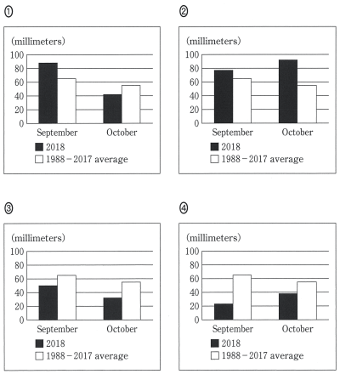
問6 Which graph are they looking at?

Slide 14
問6 正解 ④
M: In 2018, there was less rainfall than usual in September.
W: And in October?
M: Yes. It also rained less than usual.
W: But more than in September, I see.

Slide 15
第2問
第２問は問７から問13までの７問です。それぞれの問いについて対話を聞き，最後の発言に対する相手の応答として最も適切なものを，四つの選択肢(①～④)のうちから一つずつ選びなさい。

Slide 16
問7
① Well, it’ll take a while to travel.
② Well, it’s too bad that I’m busy.
③ Well, we have 10 minutes there.
④ Well, we must take the local train.

Slide 17
問7 正解 ③
W: We’ll change from the local train to the monorail at about 12, right?
M: Let me see. I’m checking the monorail schedule online now.
W: Do we have enough time to transfer?

Slide 18
問8
① I can use your dictionary.
② I don’t have any words in mind.
③ That’s the reason you shouldn’t.
④ That’s why I use them.

Slide 19
問8 正解 ④
M: What are these sticking out of your dictionary?
W: I use them whenever I look up a word.
M: Great idea! It must help you remember new words.

Slide 20
問9
① That’s why I always park my car outside.
② That’s why I never remember to do that.
③ You should write a note to remind yourself.
④ You shouldn’t get ready the day before.

Slide 21
問9 正解 ③
M: Oh no, it’s Tuesday already. I missed the trash collection.
W: Good morning, Tom. What were you saying?
M: Oh, the garbage truck’s just left and now I missed it again.

Slide 22
問10
① How will you pay for this?
② Shall I wrap it up for you?
③ What about keeping it?
④ Would you prefer to exchange it?

Slide 23
問10 正解 ④
W: Excuse me, is it possible to return this? Here’s the receipt.
M: Of course. No problem. May I ask the reason?
W: I don’t like this color on me.

Slide 24
問11
① I see. The TV stand is on the side of the room.
② I see. We’ll send someone up right away.
③ I’m sorry. I did it exactly that way.
④ I’m sorry. I’ll come to the front desk.

Slide 25
問11 正解 ②
W: Hello. Front desk? I’m in Room 302, and the TV doesn’t work.
M: Did you check the main power switch on the side of the monitor?
W: Yes. It’s on.

Slide 26
問12
① Hmm … for whom?
② Hmm … to whom?
③ Hmm … who did?
④ Hmm … who else?

Slide 27
問12 正解 ④
W: Good afternoon. We’ll get started as soon as everyone is here.
M: Tom and Kate are on their way. They’ll be here soon.
W: Umm, that leaves two more.

Slide 28
問13
① OK. First, set the table for two.
② OK. Let me get ray glasses from the kitchen.
③ OK. Thank you very much for reading it.
④ OK. Turn the power off before you begin.

Slide 29
問13 正解 ②
M: Mom, can you help me put this table together?
W: Sure. What would you like me to do?
M: Can you read the instructions to me?

Slide 30
第3問
第３問Ａは問14から問16までの３問です。それぞれの問いについて対話を聞き，答えとし７最も適切なものを，四つの選択肢(①～④)のうちから一つずつ選びなさい。

Slide 31
問14 What does the man say he is going to do?
① Study Portuguese
② Teach Portuguese
③ Visit Brazil
④ Visit Portugal

Slide 32
問14 正解 ①
W: Are you interested in joining a Portuguese language club?
M: Well, I haven’t studied Portuguese in a while.
W: Don’t worry. My friend from Brazil has a lot of teaching experience.
M: Really? Hmm, I’m not so sure.
W: Come on, it’ll be totally casual.
M: OK, I’ll give it a try.

Slide 33
問15 Why did the man give her a present?
① It was Christmas Day.
② It was her birthday.
③ It was her graduation.
④ It was their wedding anniversary.

Slide 34
問15 正解 ②
M: Here’s a little something for you, honey.
W: Wow! You remembered this year.
M: How could I forget? You’re a half century old today.
W: Thanks for reminding me.
M: Sorry. Go ahead, open it.
W: What could it be?
M: I hope you like it.
W: A diamond ring! I love it!

Slide 35
問16 On what day will they go to see the musical?
① Thursday
② Friday
③ Saturday
④ Sunday

Slide 36
問16 正解 ④
W: Look at this poster. I really want to see this musical. Do you want to go?
M: OK. When?
W: It starts today …. What about tomorrow?
M: Ah, Friday’s not good. But I’m OK on Saturday.
W: Oh, I have to work. How about the day after that?
M: Sounds good. Call me later?

Slide 37
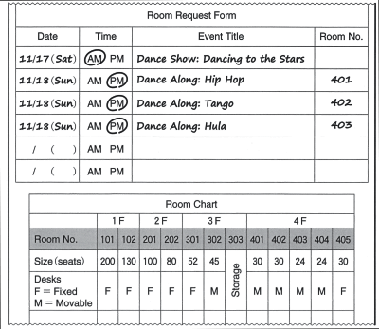
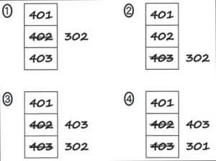
第3問 対話の場面 ダンス部の部長が，文化祭で使う教室を決めるために予約フォームを見ながら，学校の事務職員と相談をしています。
問17 In which room will the “Dance Show” most likely be held?
① 101 ② 102 ③ 201 ④ 202
問18 Why is Room 405 unsuitable for the “Dance Along”?
① It’s on the fourth floor. ② It’s too small.
③ The desks do not move.④ The Wi-Fi may not work.
問19 How will the rooms on Sunday be changed in the request form?

Slide 38
問17 正解 ② 問18 正解 ③ 問19 正解 ③
M: OK, have you filled in the request form?
W: Yes, but I’m not sure about which rooms to reserve.
M: Right. Let’s look at the room chart.
W: Sure. We’d like a large room for the “Dance Show,” but we don’t know how many people will come. Maybe, a hundred at most?
M: So, a little bit larger than that.
W: Ah … this one?
M: Uh-huh …. And you’d like the fourth floor rooms on Sunday for the “Dance Along”?
W: Yeah, they all look good. Well, not 405, though. We need to make enough space for everyone to dance.
M: Ah, of course …. Oh no. 402 and 404 are booked all day.
W: Too bad. How about the third floor?
M: Those rooms are available, but the Wi-Fi on the third floor is rather unstable. Is that OK?
W: Umm, we absolutely need Wi-Fi for “Tango,” so we’ll move “Hula” to the third floor.

Slide 39
問20 Why did the speaker begin using social media?
① To make many new friends
② To stay in contact with people
③ To take university classes online
④ To watch live videos in her dorm
問21 What event made the biggest impression on the speaker?
① A baby walking for the first time
② A family member’s travels
③ Her going away to university
④ The birth of her friend’s baby
問22 What is the main problem discussed in this story?
① People can reach you at any time of day.
② People feel their lives are inferior to others’.
③ People have stopped having many babies.
④ People have stopped meeting face-to-face.

Slide 40
問20 正解 ② 問21 正解 ② 問22 正解 ②
After high school, I went to a university that was far away from home. I could only visit my friends and family every six months. Of course, I missed them, so I started using social media. It enabled us to keep in touch with each other. When I was in my second year of university, a friend in my hometown and her husband had a baby girl. The very same day, I was able to see pictures of their daughter. A year later, on my dorm room computer, I watched a live video of her taking her first steps. What had the biggest impact on me, however, was following my sister’s adventures while she studied abroad in Spain. I hate to say it, but I started to feel envious of them because their lives seemed so perfect. This is one of the problems with social media. People only post the good things that happen to them, and without thinking about it, we compare ourselves to them. Social media allowed me to experience things I otherwise would have missed. However, it is also necessary to be aware of all the good things in our own lives.

Slide 41
会話の場面 日本の大学でJason, Bella, Ninaが，スキー部の合宿に備えて話し合いをしています。
問23 In which season is this conversation taking place?
① Spring ② Summer
③ Fall ④ Winter
問24 Why does Nina say that being well-conditioned is important?
① To maintain energy
② To maintain flexibility
③ To maintain speed
④ To maintain strength
問25 What is the result of this discussion?
① They will focus equally on flexibility and strength.
② They will focus equally on stamina and strength.
③ They will focus more on flexibility than strength.
④ They will focus more on stamina than strength.

Slide 42
問23 正解 ② 問24 正解 ① 問25 正解 ④
Jason : Hi, Bella. Nina and I were just talking about how excited we are about our ski trip this coming January.
Bella : Me too, but I’m worried whether my body can handle skiing for two weeks. I’m stretching every day to improve my flexibility, but I don’t think it’s enough.
Nina : Why don’t we start an exercise program to help us prepare?
Bella : That’s a great idea, Nina, but what do you recommend? Should we focus on muscle strength or stamina?
Nina : Well, I think the most important thing is to improve our stamina. We’ll be skiing on some of the most challenging mountains in Canada. If we’re not well-conditioned, we’ll run out of energy quickly. What do you think, Jason?
Jason : Exactly. I think we should start jogging … maybe five kilometers a day, and gradually work our way up to ten. What do you think, Bella?
Bella : I agree, but I think we should also focus a little on strength. If our legs aren’t strong enough, we won’t be able to make sharp turns … or stop quickly. It’s good to be able to ski all day, but if we get injured, our trip will be over! If we only focus on stamina, we won’t have enough muscle.
Jason : I guess so. Nina, do you have any suggestions for building up strength?
Nina : Well, in addition to the jogging, maybe every other day we could do weight training. I recommend squats. That’ll really make our legs stronger.
Jason : Bella, are you OK with Nina’s idea?
Bella : I think every other day is too much. We have only six months before our trip, and I think stamina has to be our priority. What do you say, Nina?
Nina : Sounds good.
Jason : OK. Let’s go running on Mondays and Fridays, and then go to the weight room on Wednesdays. This would give us the best mix of stamina and strength.

