Slide 1
共通テストH29施行 リスニングA

Slide 2
第1問
問１～３は、聞こえてくる英文の内容に最も近い意味の英文を、四つの選択肢（①～④）のうちから一つずつ選びなさい。

Slide 3
問1
① I called the police.
② I have the bike key.
③ The police found the key.
④ The police lost the key.

Slide 4
問1 正解 ③
M: The police just called and told me they have the bike key I lost.

Slide 5
問2
① She is asking for the menu.
② She is cooking in the kitchen.
③ She is serving some dishes.
④ She is taking their order.

Slide 6
問2 正解 ④
W: Here are your menus. Today’s specials are beef and chicken. Can I get you something to drink first?

Slide 7
問3
① He did better on the science exam.
② He got poor scores on both tests.
③ He scored worse on the math exam.
④ He studied enough for the tests.

Slide 8
問3 正解 ②
M: Tom didn’t do well on the math exam and did even worse on the science one.

Slide 9
問４～５は、聞こえてくる英文の内容に最も近い絵を、四つの選択肢（①～④）のうちから一つずつ選びなさい。

Slide 10
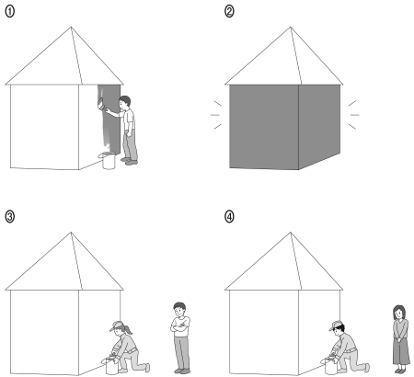
問4

Slide 11
問4 正解 ③
W: The man is going to have his house painted.

Slide 12
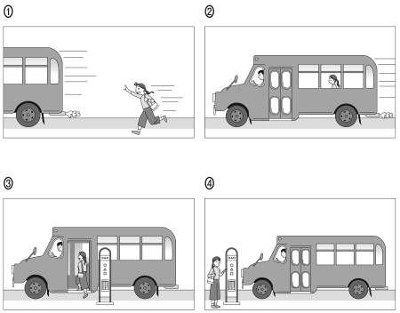
問5

Slide 13
問5 正解 ①
M: The woman has just missed the bus.

Slide 14
問６～８は、対話とそれについての問いを聞き、その答えとして最も適切なものを、四つの選択肢（①～④）のうちから一つずつ選びなさい。

Slide 15
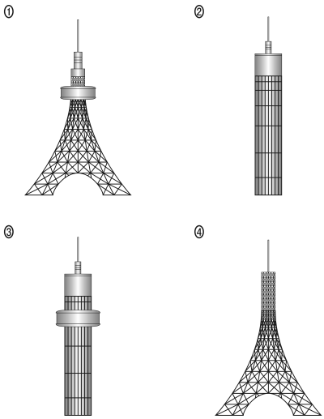
問6 観光中の二人が，高いタワーを見て話をしています。

Slide 16
問6 正解 ①
M: Look at that tower! It has such a pointed top!
W: And I like the wide base.
M: What’s the disk-shaped part near the top?
W: It’s probably a restaurant.
Question:What does the tower look like?

Slide 17
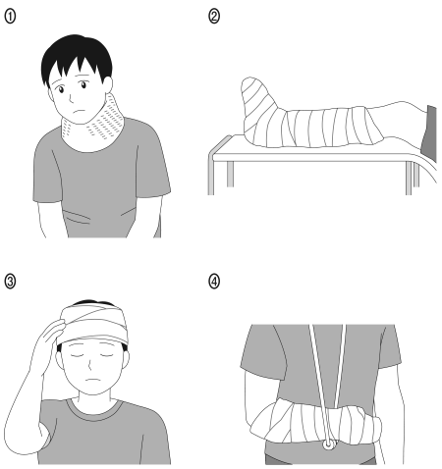
問7 ケガをした患者と医者が話をしています。

Slide 18
問7 正解 ④
M: How long do I have to wear this?
W: At least six weeks.
M: How will I take notes in class, then?
W: You’ll have to talk to your teacher about that.
Question : Which picture shows the patient’s condition?

Slide 19
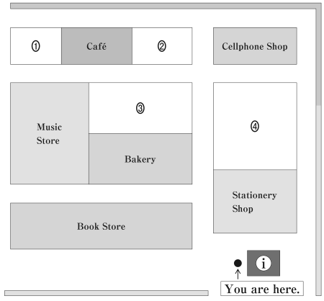
問8買い物客がショッピングモールの案内所で尋ねています。

Slide 20
問8 正解 ②
M: I’m looking for a smartphone case.
W: Try the cellphone shop.
M: I did, but I couldn’t find any.
W: You could try the shop across from the cellphone shop, next to the cafe.
Question:Where will the customer most likely go next?

Slide 21
第3問
問９～１１は、対話を聞き、問いの答えとして最も適切なものを、四つの選択肢（①～④）のうちから一つずつ選びなさい。

Slide 22
問9 友達同士が，これから出かけようとしています。
Which bus are the two friends going to catch?
① 11:05
② 11:15
③ 11:20
④ 11:40

Slide 23
問9 正解 ④
M: What time do we have to leave?
W: Let me check the schedule…. What time is it now?
M: It’s 11:15.
W: The next bus is in five minutes, and then there’s one at 11:40.
M: I don’t think we can make it for the next one. Let’s take the one after that.

Slide 24
問10 テレビで野球の試合（The Crabs 対The Porters）を見ているお母さんに，息子が話しかけています。
What is happening in the game?
① The Crabs are behind.
② The Crabs are leading.
③ The game is being delayed.
④ The game is just beginning.

Slide 25
問10 正解 ②
M: Oh, you’re watching the baseball game, Mom.
W: Yes. It’s exciting.
M: I didn’t know that it had already started. Are the Crabs ahead?
W: They are right now, yes, although they were losing in the beginning. They caught up with the Porters and they’re leading now.
M: I hope they’ll win.

Slide 26
問11 語学学校に留学中の女子学生が，アドバイザーと話をしています。
What happened to the student?
① Her question wasn’t answered.
② Her request wasn’t accepted.
③ She was told not to give advice.
④ She was unable to make a suggestion.

Slide 27
問11 正解 ②
W: I’d like to move to an easier class. Would that be possible?
M: You have to get permission from your teacher. Who is your teacher?
W: Ms. Allen. She said I should stay in her class for the rest of the year.
M: Then, that’s what you’ll have to do.

Slide 28
第4問
問１２は、四人の英語を聞き、問いの答えとして最も適切なものを、四つの選択肢（①～④）のうちから一つずつ選びなさい。

Slide 29
問12
状況
日本の観光案内所で外国人観光客を案内する高校生ボランティアスタッフを1 名募集しました。その結果，複数の応募があったため，以下のような条件に沿って選ぶことにしました。
条件
・観光案内や通訳をしたことのある人。
・外国人観光客に対応できる英語力（中級から上級）のある人。
・週末の午後1 時から5 時まで参加できる人。
四人の応募者の録音された自己紹介を聞き，最も条件に合う人物を選びなさい。
① Akiko KONDO
② Hiroshi MIURA
③ Keiko SATO
④ Masato TANAKA

Slide 30
問12 正解 ③
・Hello, this is Akiko speaking. I, um, I just started studying English hard. I want to, uh, improve my speaking skills. I like, uh, I want to practice with people from foreign countries. This job is perfect for that. I have a parttime job on Sunday evenings. Thank you!
・Hi, I’m Hiroshi, but my friends call me “Hiro.” I lived in Canada for 3 years and I’m pretty fluent in English. Currently, I work as an interpreter on weekends. I’d love to help out! Please let me know if you need any other information. Thanks. Bye!
・Good morning. This is Keiko. I was an exchange student in Australia for a year and I’m a volunteer guide for foreign visitors at my school. I’m available most days, but Wednesday evenings I’ve got and practice. Thank you for your time. Bye.
・Hi, my name’s Masato. My English is good, but it will be my first time doing a volunteer work using English. I’m applying because I hope to gain that kind of experience. I’m free on most weekdays except for Thursdays. Please consider me for this position! Goodbye.

Slide 31
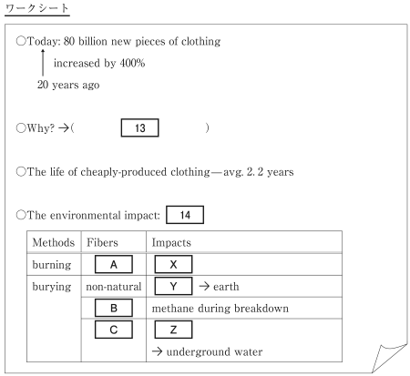
状況 アメリカの大学で，服と環境の関わりについて，講義を聞いています。
問13 ワークシートの空欄13を埋めるのに最も適切なものを，四つの選択肢（①～④）のうちから一つ選びなさい。
① carefully produced and expensive clothes
② cheaply produced and inexpensive clothes
③ poorly produced and short-lasting clothes
④ reasonably produced and long-lasting clothes
問14 ワークシートの表14の空欄Ａ～Ｃ及びＸ～Ｚを埋めるのに最も適切な語句はどれか。Fibers の空欄Ａ～Ｃのそれぞれにあてはまるものを二つの選択肢（①と②）のうちから，Impactsの空欄Ｘ～Ｚのそれぞれにあてはまるものを三つの選択肢（③ ～ ⑤）のうちから選びなさい。① と ② は二回以上使われることがあります。
空欄Ａ～Ｃ：
① natural ② non-natural
空欄Ｘ～Ｚ：
③ chemicals used in production
④ many years to break down
⑤ CO2 in the air

Slide 32
問15 講義で話されていると考えられる主張はどれか、四つの選択肢（① ～ ④）のうちから一つ選びなさい。
① Cotton clothes are better because they produce less CO2 and are more easily broken down than polyester clothes.
② It is better to burn textile waste than to bury it underground because harmful chemicals can damage the earth.
③ Many clothes are not recycled or reused, so buying clothing wisely could contribute to protecting the environment.
④ We should avoid buying unnecessary clothing because chemicals are used during the production process.

Slide 33
問13 正解 ② 問14 正解 A② B① C① X⑤ Y④ Z③
問15 正解 ③
Do you like buying new clothes? Today I’m going to talk about clothing and its connection to the environmental crisis we are facing now. Worldwide, we consume about 80 billion items of new clothing each year. That number is 400% higher than what we were consuming two decades ago. Do you know why? This increase is closely related to the fact that clothes are cheaply produced and sold at low prices. How long do you wear your clothes? The life of such cheaply produced clothing is, on average, 2.2 years. Some clothing stores are trying hard to reuse or recycle the clothes. But unfortunately, tons of clothes still end up being burned or buried as waste. Burning or burying such a large amount of textile waste adds to our present environmental crisis. Burning non-natural fibers such as polyester and nylon can produce air pollution including a huge amount of CO2.
Burying unwanted clothes also causes a lot of pollution. Do you know how long the buried clothes stay in the ground? Those non-natural fibers are basically plastics made from oil, which means they could take up to a thousand years to become part of the earth once again. In contrast, natural fibers like cotton and silk go back to the earth quickly. However, they produce greenhouse gases, such as methane, as they break down under the ground. In addition, chemicals may have been used to dye or bleach those natural fibers, and the remaining chemicals can eventually reach underground water.

Slide 34
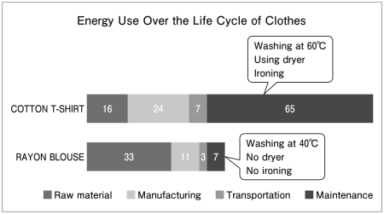
問16 講義の続きを聞いて以下の図表から読み取れる情報と，先の講義の内容を総合して，どのようなことが示唆されるか，四つの選択肢（①～④）のうちから一つ選びなさい。
① Cotton T-shirts are better for the earth when they are made out of chemical-free fibers.
② It is important not only to think of what clothes to buy but how to take care of them.
③ Rayon blouses can be recycled and as a result, last longer than cotton T-shirts.
④ We should wear natural-fiber clothing as it is friendly to the environment.

Slide 35
問16 正解 ②
Now let’s consider how much energy is used in the life cycle of clothing. Look at this chart comparing a cotton T-shirt and a rayon blouse. Although rayon looks like a non-natural material, it is actually made from wood pulp. Notice the differences between these two types of natural-fiber clothes.

Slide 36
第6問 状況 二人の大学生が、日本の高校で行った修学旅行について英語の授業で話しています。
問１７ What is the woman’s main point?
① She found it difficult to use English in Australia.
② She thinks a school trip abroad is worthwhile.
③ She wanted more chances to travel outside Japan.
④ She wishes she had gone to Hiroshima instead.
問１８ What is the man’s main point?
① He disliked being asked questions about Japan.
② He felt that domestic school trips should be longer.
③ He thought he wasn’t able to appreciate his school trip.
④ He wanted to go to Australia instead of Nara.

Slide 37
問17 正解 ② 問18 正解 ③
M: We went to Australia on our school trip.
W: Nice! We only went to Tokyo. I’ve never been abroad, and I wish I could have gone when I was a high school student.
M: Oh, yeah? In fact, looking back, I wish I had gone somewhere in Japan like Hiroshima or Nara because I wasn’t ready to go abroad yet.
W: What do you mean? You can go to places like that any time. Maybe you wouldn’t have had a chance to go abroad otherwise.
M: I wish I had known more about Japan back then. People in Australia asked me a lot of questions about Japan, but it was very hard for me to answer them. Also, I needed more English skills.
W: But, didn’t you find that using English in real situations improved your skills? I wish I had had that opportunity.
M: No, not really. The trip was too short to really take advantage of that.
W: In any case, such an experience should be appreciated.

Slide 38
状況
学生たちが授業で，炭水化物（carbohydrates）を積極的に摂取することに対して賛成か反対かを述べています。
問１９ 四人の意見を聞き，賛成意見を述べている人を四つの選択肢（①～④）のうちからすべて選びなさい。正解となる選択肢は一つとは限りません。
① 学生1
② 学生2
③ 学生3
④ 学生4

Slide 39
問19 正解 ① ④
Student 1 Test season is in a few weeks, and carbohydrates are the preferred source of energy for mental function. I think rice, potatoes, pasta and bread are good brain food! You are what you eat!
Student 2 Many people try to reduce the fat in their diet, but instead they should lower the amount of carbohydrates they eat. In one study, people on a high carbohydrate diet had an almost 30% higher risk of dying than people eating a low carbohydrate diet.
Student 3 The necessary calories for the body can be taken in from protein and fat, which are included in foods such as meat and nuts. The body requires these for proper functioning. Protein and fat previously stored in the body can be used as a more reliable source of energy than carbohydrates.
Student 4 Well, as an athlete, I need to perform well. My coach said that long distance runners need carbohydrates to increase stamina and speed up recovery. Carbohydrates improve athletic performance. Athletes get less tired and compete better for a longer period of time.

Slide 40
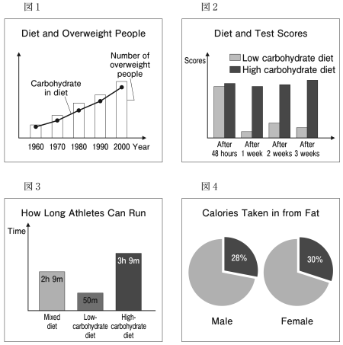
問２０
さらに別の学生の意見を聞き，その意見の内容と合う図を四つの選択肢（①～④）のうちから一つ選びなさい。
① 図1
② 図2
③ 図3
④ 図4

Slide 41
問20 正解 ①
If I eat a high carbohydrate diet, I tend to get hungry sooner and then eat snacks. Also, I read snacks raise the sugar levels in the blood, and the ups and downs of blood sugar lead to eating continuously. This makes you gain excessive weight.

