Slide 1
共通テストH30施行 リスニング

Slide 2
第1問
それぞれの問いについて，聞こえてくる英文の内容に最も近い意味のものを，四つの選択肢（①〜④）のうちから一つずつ選びなさい。

Slide 3
問1
① The speaker does not want anything.
② The speaker wants both tea and cookies.
③ The speaker wants cookies.
④ The speaker wants tea.

Slide 4
問1 正解 ④
I’ve had enough cookies, thanks. Some more tea would be nice.

Slide 5
問2
① The speaker cannot go to the party.
② The speaker does not have work tomorrow.
③ The speaker has another party to go to.
④ The speaker’s birthday is tomorrow.

Slide 6
問2 正解 ①
I’d love to go to your birthday party tomorrow, but I have a lot of work to do.

Slide 7
問3
① Junko got wet in the rain.
② Junko had an umbrella.
③ Junko ran to school in the rain.
④ Junko stayed at home.

Slide 8
問3 正解 ①
It started raining after school. Since Junko had no umbrella, she ran home in the rain.

Slide 9
問4
① The speaker is an English teacher.
② The speaker must study a lot.
③ The speaker needs to study outside of Japan.
④ The speaker teaches English abroad.

Slide 10
問4 正解 ②
To become an English teacher, I won’t have to study abroad, but I will have to study hard.

Slide 11
それぞれの問いについて，聞こえてくる英文の内容に最も近い絵を，四つの選択肢（①〜④）のうちから一つずつ選びなさい。

Slide 12
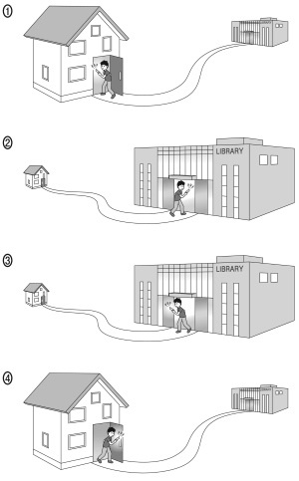
問1

Slide 13
問1 正解 ①
He got a phone call from Joe as soon as he arrived home from the library.

Slide 14
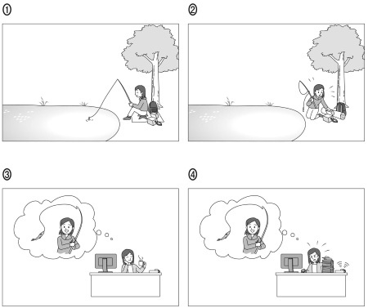
問2

Slide 15
問2 正解 ④
Right now, she’s too busy to go to the lake and fish.

Slide 16
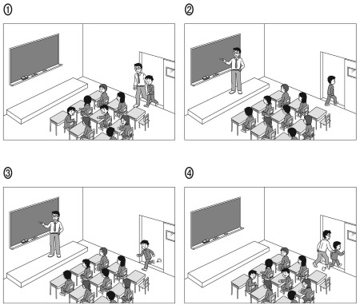
問3

Slide 17
問3 正解 ③
When the boy entered the classroom, the teacher had already started the lesson.

Slide 18
第2問
それぞれの問いについて，対話の場面が日本語で書かれています。対話とそれについての問いを聞き，その答えとして最も適切なものを，四つの選択肢（① 〜 ④）のうちから一つずつ選びなさい。

Slide 19
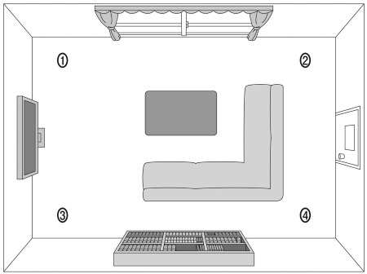
問1 居間でクリスマスツリーの置き場所について話をしています。

Slide 20
問1 正解 ②
M: How about there, near the bookshelf?
W: I’d prefer it by the window.
M: OK. Right here, then?
W: No, that’s too close to the TV. I think the other corner would be better.
Question: Where does the woman want to put the Christmas tree?

Slide 21
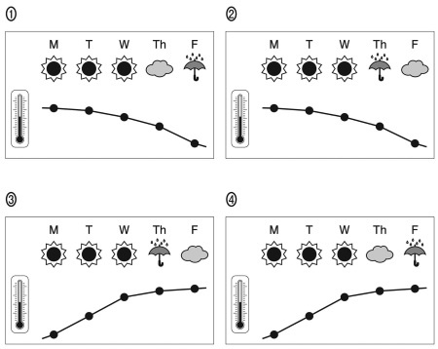
問2 来週の天気について話をしています。

Slide 22
問2 正解 ③
W: Will it be warm next week?
M: It should be cold at first, then get warmer.
W: I heard it’ll be sunny, though, right?
M: Yes, except for rain on Thursday and clouds on Friday.
Question: Which is the correct weather forecast?

Slide 23
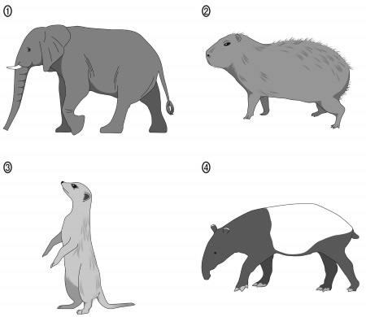
問3 動物園で見てきた動物について話をしています。

Slide 24
問3 正解 ④
M: What was the name of the animal with the small ears?
W: The one with the long tail?
M: No, the short-tailed one.
W: Oh yeah, with the long nose.
Question: Which animal are the speakers talking about?

Slide 25
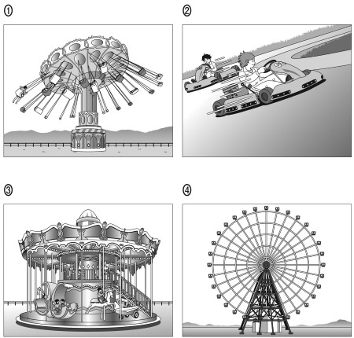
問4 遊園地で乗り物の話をしています。

Slide 26
問4 正解 ③
W: This place is famous for its roller coaster!
M: Oh … no, I don’t like fast rides.
W: Well then, let’s try this!
M: Actually, I’m afraid of heights, too.
Question: Which is the best ride for the man to try?

Slide 27
第3問
それぞれの問いについて，対話の場面が日本語で書かれています。対話を聞き，問いの答えとして最も適切なものを，四つの選択肢（① 〜 ④）のうちから一つずつ選びなさい。（問いの英文は書かれています。

Slide 28
問1 夫婦が今夜の夕食について話をしています。
What is the couple going to eat for dinner?
① Pasta and salad
② Pasta and soup
③ Pizza and salad
④ Pizza and soup

Slide 29
問1 正解 ①
W: Would you rather have pizza or pasta for dinner?
M: Well, I had pizza for lunch ….
W: OK, then pasta. We could have soup with that. Oh, but the neighbor gave us lots of lettuce and tomatoes from her garden, so how about a salad instead of soup?
M: Sure! That sounds good!

Slide 30
問2 男性が通行人に話しかけています。
What will the man do?
① Ask for a ride.
② Take a bus.
③ Take a taxi.
④ Walk to the hotel.

Slide 31
問2 正解 ④
M: Excuse me. Could you tell me how to get to the Riverside Hotel from here?
W: You can take a taxi or a bus. Or you can walk there and enjoy the view. It’s not too far.
M: Hmm, it’s a nice day, and I need some exercise. I’ll do that.

Slide 32
問3 友達同士が服装について話をしています。
How does the man feel about the shirt?
① He likes it very much.
② He wants to buy it.
③ It doesn’t look nice on him.
④ It isn’t worth the price.

Slide 33
問3 正解 ①
W: Hi, Jason. You look great in that shirt.
M: Thanks, Mary. I ordered it online. Actually, it didn’t look that nice on the website.
W: Then why did you buy it?
M: Because it was 50% off. But now I think it’s really nice.
W: Yeah, it is! You got a good buy.

Slide 34
問4 友達同士が今観た映画について話をしています。
What do the two people agree about?
① The movie follows the book.
② The movie has a great cast.
③ The movie is based on a true story.
④ The movie is better than the book.

Slide 35
問4 正解 ①
M: That was a great movie, wasn’t it?
W: Well, it wasn’t as good as I expected.
M: Really? It was a lot like the book, though.
W: Yeah, that’s true, but I didn’t like the cast very much.
M: Oh, you didn’t? I think all the actors did a great job.

Slide 36
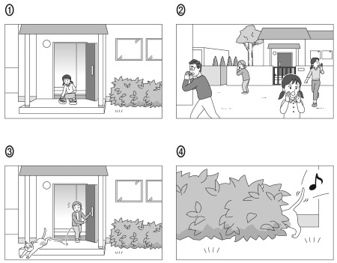
第4問 問1 女の子がペットの猫（サクラ）について話しています。話を聞き，その内容を表したイラスト（①〜④）を，聞こえてくる順番に並べなさい。

Slide 37
正解 ③→②→①→④
Last Saturday, when my grandmother opened the front door of our house, our family cat, Sakura, ran out to chase a bird. My grandmother tried to catch her, but Sakura was too fast. My family began looking for her. When it got too dark to see, we gave up our search for the night. We were so sad. I placed food and water outside the door in case Sakura came home. The next morning I ran to the door to check the food. The food had been eaten, but Sakura wasn’t there. Then suddenly, from behind the bushes, I heard a soft “meow.”

Slide 38
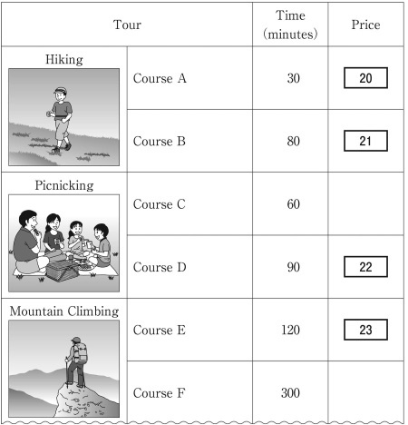
あなたは海外インターンシップで旅行代理店の手伝いをしています。ツアーの料金についての説明を聞き，下の表の四つの空欄｜20｜〜｜23｜ にあてはめるのに最も適切なものを，五つの選択肢（①〜⑤）のうちから一つずつ選びなさい。選択肢は2 回以上使ってもかまいません。
① $50 ② $70 ③ $100
④ $150 ⑤ $200

Slide 39
正解 [ 20 ] ② [ 21 ] ③ [ 22 ] ③ [ 23 ] ④
This is the list of outdoor tours that we offer. I haven’t filled in the price column yet, so could you help me complete it? The prices depend on how long each tour is. The price is 70 dollars for tours up to one hour … and 100 dollars for tours over 60 minutes up to 90 minutes. We charge 50 dollars for each additional hour over 90 minutes.

Slide 40
四人の説明を聞き，問いの答えとして最も適切なものを，選択肢のうちから選びなさい。メモを取るのに下の表を使ってもかまいません。
状況：あなたは大学に入学した後に住むための寮を選んでいます。寮を選ぶにあたり，あなたが考えている条件は以下のとおりです。
条件
Ａ．同じ寮の人たちと交流できる共用スペースがある。
Ｂ．各部屋にバスルームがある。
Ｃ．個室である。
問1 先輩四人が自分の住んでいる寮について説明するのを聞き，上の条件に最も合う寮を，四つの選択肢（① 〜 ④）のうちから一つ選びなさい。
① Adams Hall
② Kennedy Hall
③ Nelson Hall
④ Washington Hall

Slide 41
正解 ④
1. You’d love Adams Hall. It’s got a big recreation room, and we have parties there every weekend. You can also concentrate on your studies because everyone gets their own room. The bathrooms are shared, though.
2. I recommend Kennedy Hall. All the rooms are shared, and the common area is huge, so we always spend time there playing board games. There’s a bathroom in every room, which is another thing I like about my hall.
3. I live in Nelson Hall. There are private rooms, but only for the seniors. So, you’ll be given a shared room with no bathroom. My favorite place is the common kitchen. We enjoy sharing recipes from different countries with each other.
4. You should come to Washington Hall. The large living room allows you to spend a great amount of time with your friends. Each room has a bathroom. Some rooms are for individual students, and, if you apply in advance, you will surely get one of those.

Slide 42
第5問
講義を聞き，それぞれの問いの答えとして最も適切なものを，選択肢のうちから選びなさい。状況と問いを読む時間（約60秒）が与えられた後，音声が流れます。
状況：あなたはアメリカの大学で，技術革命と職業の関わりについて，ワークシートにメモを取りながら，講義を聞いています。

Slide 43
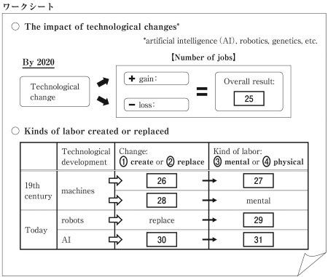
問１(a) ワークシートの空欄[25]にあてはめるのに最も適切なものを，六つの選択肢（①〜⑥）のうちから一つ選びなさい。
① a gain of 2 million jobs
② a loss of 2 million jobs
③ a gain of 5 million jobs
④ a loss of 5 million jobs
⑤ a gain of 7 million jobs
⑥ a loss of 7 million jobs
問１(b) ワークシートの表の空欄[26]～[31]にあてはめるのに最も適切なものを，四つの選択肢（①〜④）のうちから一つずつ選びなさい。選択肢は2 回以上使ってもかまいません。
① create ② replace
③ mental ④ physical

Slide 44
問１(c) 講義の内容と一致するものはどれか。最も適切なものを，四つの選択肢（①〜④）のうちから一つ選びなさい。
① Machines are beginning to replace physical labor with the help of robots.
② Mainly blue-collar workers will be affected by the coming technological changes.
③ Two-thirds of the number of women working at an office will lose their jobs.
④ White-collar workers may lose their present jobs because of AI developments.

Slide 45
正解 (a)⑤ (b)②④①②④③ (c) ④
What kind of career are you thinking about now? Research predicts developments in artificial intelligence, robotics, genetics, and other technologies will have a major impact on jobs. By 2020, two million jobs will be gained in the so-called STEM fields, that is, science, technology, engineering, and mathematics. At the same time, seven million other jobs will be lost.
This kind of thing has happened before. Jobs were lost in the 19th century when mass production started with the Industrial Revolution. Machines replaced physical labor, but mental labor like sales jobs was generated. Today, many people doing physical labor are worried that robots will take over their roles and that they will lose their current jobs. This time, the development of AI may even eliminate some jobs requiring mental labor as well.
Actually, we know that robots are already taking away blue-collar factory jobs in the US. Moreover, because of AI, skilled white-collar workers, or intellectual workers, are also at “high risk.” For example, bank clerks are losing their jobs because computer programs now enable automatic banking services. Even news writers are in danger of losing their jobs as AI advances enough to do routine tasks such as producing simple news reports.
As I mentioned earlier, seven million jobs will be lost by 2020. Two-thirds of those losses will be office jobs. Since most office jobs are done by women, they will be particularly affected by this change. What’s more, fewer women are working in the STEM fields, so they will benefit less from the growth in those fields.

Slide 46
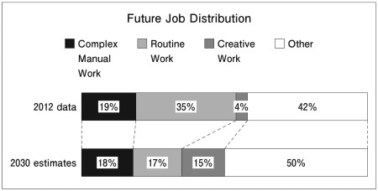
問2 講義の続きを聞き，下の図から読み取れる情報と講義全体の内容から，どのようなことが言えるか，最も適切なものを，四つの選択肢（①〜④）のうちから一つ選びなさい。
① Complex manual work will be automated thanks to the technological revolution.
② Jobs in the STEM fields will not increase even though they require creative work.
③ Mental work will have the greatest decrease in percentage.
④ Not all physical work will be replaced by robots and AI.

Slide 47
問2 正解 ④
Let’s take a look at the graph of future job changes. Complex manual workers, like cooks and farmers, are different from routine workers in factories and offices. Creative workers include artists and inventors. So, what can we learn from all this?

Slide 48
第6問 状況：二人の大学生が，ゲーム(video games)について話しています。
問1 What is Fred’s main point?
① Video games do not improve upper body function.
② Video games do not represent the actual world.
③ Video games encourage a selfish lifestyle.
④ Video games help extend our imagination.
問2 What is Yuki’s main point?
① It’s necessary to distinguish right from wrong in video games.
② It’s wrong to use smartphones to play video games.
③ Players can develop cooperative skills through video games.
④ Players get to act out their animal nature in video games.

Slide 49
問1 正解 ② 問2 正解 ③
Fred: Are you playing those things again on your phone, Yuki?
Yuki: Yeah, what’s wrong with playing video games, Fred?
Fred: Nothing. I know it’s fun; it enhances hand-eye coordination. I get that.
Yuki: Oh, then you’re saying it’s too violent; promotes antisocial behavior ― I’ve heard that before.
Fred: And, not only that, those games divide everything into good and evil. Like humans versus aliens or monsters. The real world is not so black and white.
Yuki: Yeah …. We are killing dragons. But we learn how to build up teamwork with other players online.
Fred: Building up teamwork is different in real life.
Yuki: Maybe. But still, we can learn a lot about how to work together.
Fred: Well, I’ll join you when you have a game that’ll help us finish our homework.

Slide 50
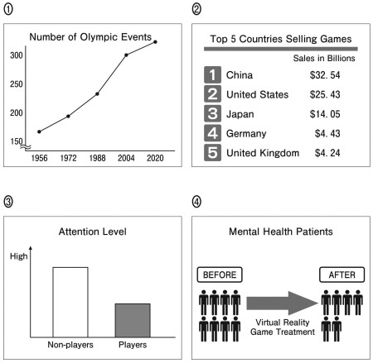
状況：Professor Johnson がゲーム(video games)について講演した後，質疑応答の時間がとられています。司会(moderator)が聴衆からの質問を受け付けています。Bill とKaren が発言します。
問1 四人のうち，ゲームに反対の立場で意見を述べている人を，四つの選択肢（①〜④）のうちからすべて選びなさい。
① Bill
② Karen
③ Moderator
④ Professor Johnson
問2 Professor Johnsonの意見を支持する図を，四つの選択肢（①〜④）のうちから一つ選びなさい。

Slide 51
問1 正解 ① 問2 正解 ④
Moderator: Thank you for your presentation, Professor Johnson. You spoke about how one boy improved his focus and attention through video games.
Professor Johnson: Right. Playing video games can make people less distracted. Furthermore, virtual reality games have been known to have positive effects on mental health.
Moderator: OK. Now it’s time to ask our audience for their comments. Anyone …? Yes, you, sir.
Bill: Hi. I’m Bill. All my friends love video games. But I think they make too clear a distinction between allies and enemies … you know, us versus them. I’m afraid gaming can contribute to violent crimes. Do you agree?
Professor Johnson: Actually, research suggests otherwise. Many studies have denied the direct link between gaming and violence.
Bill: They have? I’m not convinced.
Professor Johnson: Don’t make video games responsible for everything. In fact, as I said, doctors are succeeding in treating patients with mental issues using virtual reality games.
Moderator: Anyone else? Yes, please.
Karen: Hello. Can you hear me? OK. Good. I’m Karen from Detroit. So, how about eSports?
Moderator: What are eSports, Karen?
Karen: They’re video game competitions. My cousin made a bunch of money playing eSports in Germany. They’re often held in large stadiums … with spectators and judges … and big awards, like a real sport. In fact, the Olympics may include eSports as a new event.
Moderator: … eSports. Professor?
Professor Johnson: Uh-huh. There are even professional leagues, similar to Major League Baseball. Well, eSports businesses are growing; however, eSports players may suffer from health problems.
Moderator: I see. That’s something to consider. But right now let’s hear from another person.

